Slide 1





η-LSTM: Co-Designing Highly-Efficient Large LSTM Training via Exploiting Memory-Saving and Architectural Design Opportunities
Xingyao Zhang^{1,2}, Haojun Xia³, Donglin Zhuang³, Hao Sun³, Xin Fu¹, Michael Taylor², and Shuaiwen Leon Song³
1. ECOMS Lab, University of Houston
2. Bespoke Silicon Group, University of Washington
3. FSA Lab, University of Sydney
(xingyaoz@cs.washington.edu)
Notes:
Hello Everyone, I am Xingyao Zhang, a postdoc scholar from the Bespoke Silicon Group from University of Washington. Welcome to our talk on highly-efficient large LSTM training via memory-saving and architectural design optimizations. This work is a collaborative work between University of Houston, University of Washington, and University of Sydney.

Slide 2
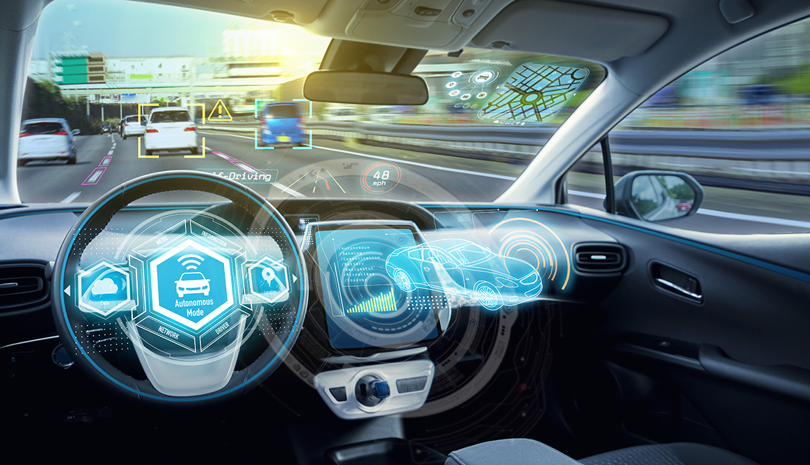




Long-Short Term Memory (LSTM) Networks
Autonomous Driving
Natural Language Processing
Business Processing Management
Medical Diagnosis
Robotic Control
Dataset Scale are Dramatically Increasing
LSTM Models Become Large
Notes:
LSTM stands for long short term memory network
This is one of the most popular type of the recurrent neural network. And this kind of neural networks has been widely applied into real world applications
So we can see that LSTM becomes more and more important, the use cases are increasing and its dataset scale also grows. Which eventually makes the LSTM model become larger and larger
Then these large model becomes complex and hard to train for both realtime on-device training or offline training.

Slide 3
State-of-the-art LSTM Training
MatMul
➔ GEMM
Element Wise
output
Context
LSTM
Forward (FW)
FW Cell
FW Cell
FW Cell
Unroll
input
Output gradient
GEMM
Element Wise
Context gradient
LSTM Backprop (BP)
BP Cell
BP Cell
BP Cell
Unroll
Input gradient
Notes:
Let’s take a look at how the state-of-the-art training for a LSTM layer is conducted
The LSTM layer should first perform forward execution, which takes the input and generate the output
Unlike a CNN, it also needs the historical output as another input to pass the context information back
Generally, a LSTM forward layer can be unrolled into a sequence of the cells, and each cell takes only partial inputs and context to produce partial outputs
The cell computation are shown in the zoom in figure
These computation can be grouped into two execution kernels: one is the general matrix multiplication (GEMM), and another is the element-wise operations.
Similarly, the LSTM backpropagation processing can also be unrolled and it takes the exactly reversed computational direction
The computation of a BP cell can also be grouped into a gemm kernel and an element-wise kernel.

Slide 4
When LSTM Models Become Large
Performance and energy efficiency decreases when increasing the model size
Training becomes increasingly infeasible to be conducted on GPU
State of art training solution doesn’t scale with increasing LSTM model size
Notes:
When LSTM models become large, what will happen for the training performance and energy?
To get the sense of this, we test the throughput and energy efficiency for LSTM training when the models become larger and larger.
There are three ways to increasing the model size, either by increasing hidden size or layer number or layer length (number of cells in one layer)
The test was conducted on the latest GPUs, Nvidia V100 and RTX 5000.
We have the high level observation that:
performance and energy efficiency significantly decreases when increasing the model size
Training becomes increasingly infeasible to be conducted on GPU
State of art training solution doesn’t scale with increasing LSTM model size

Slide 5
Contribution #1: Characterization
In addition to parameters and activations, Intermediate variables play an important role
Previous solution (Re-computation) can hardly work for LSTM Training
Notes:
To figure out why large LSTM training becomes inefficient, we first perform detailed characterization on LSTM execution.
We discover that the element wise computation produces a large amount of the intermediate variables.
When only performing inference, you don’t have to care about these. But when it comes to training, these intermediate variables will need to be stored and loaded back for backpropagation.
So previous works has some re-computation strategies to reduce the data movement for CNN and transformer, which is basically store only partial data and re-compute to get all of them during the backpropagation
But for LSTM, the computation towards these data are too large, basically you need to re-calculate nearly all forward computation.

Slide 6
Contribution #1– Characterization
1.08x
4.34x
Intermediate variables caused an average of 1.08x and 4.34x more data movement compared to parameters and activations, respectively.
Intermediate variables occupy an average of 47.18% (up to 74.01%) of the total memory footprint.
Notes:
To quantify the impact of intermediate variables, we evaluate both the data movements and memory footprint breakdown for different LSTM models.
We observe that: (1) much more significant data movements are caused by intermediate variables than both parameter and activations;
and (2) intermediate variables takes the major part of the total memory footprint. Xxxx(mention number)

Slide 7
Contribution #2 – Software-Level Design Novelty
Cell Level Reduction for Intermediate Variables
BP Layer Length Reduction
Some BP cell computation can be moved to FW Stage.
These computation produce sparse data.
Execution Reordering Opportunities
Some BP cells contribute nearly nothing to weight update
Reduce BP layer length to reduce computation and data movement
Notes:
So in order to address the inefficient LSTM training
We first have two optimizations from our software level design.
We propose to reduce intermediate variables at the cell level as well as reduce the BP layer length to reduce the data movement.
For cell level reduction of intermediate variables, based on our two major observations that some BP computations can be rescheduled to forward stage and its output is sparse, we are able to redesign LSTM execution flow to replace the intermediate variables need to be stored with sparser ones so that a more efficient large LSTM training can be enabled.
For BP layer length reduction, another way to reduce LSTM model size, we have an important finding that some BP cells offer insignificant contribution to the weight update, and leverage this fact to design a BP layer length reduction scheme. We will introduce these details in a little bit.

Slide 8
Contribution #3 – Hardware-Level Design Novelty
Our hardware design can effectively support software optimizations
Low level – Our novel Omni-PE design achieves high logic utilization
➔ improves hardware throughput and energy efficiency.
High level – Our architecture can pipeline the execution for GEMM and EW kernels w/ computation resource dynamically scheduled.
  ➔ Reduce data movement
Notes:
We propose a new hardware design that complements these software optimizations, and it further improves the LSTM training efficiency as follows:
At a Low level: we introduce the omni-pe design that the logic will be reused for different functionality that help achieve a high logic utilization. This will eventually benefit the hardware throughput and energy efficiency.
At a High level: our eta-LSTM can pipeline two kernels’ execution. And the computation resource is dynamically scheduled, so it won’t be idle logic that harm the overall performance.
The control overhead is small because the execution pattern is kinda fixed. With gemm and element-wise kernel pipelined, massive intermediate data between these two kernels can be quickly consumed.

Slide 9
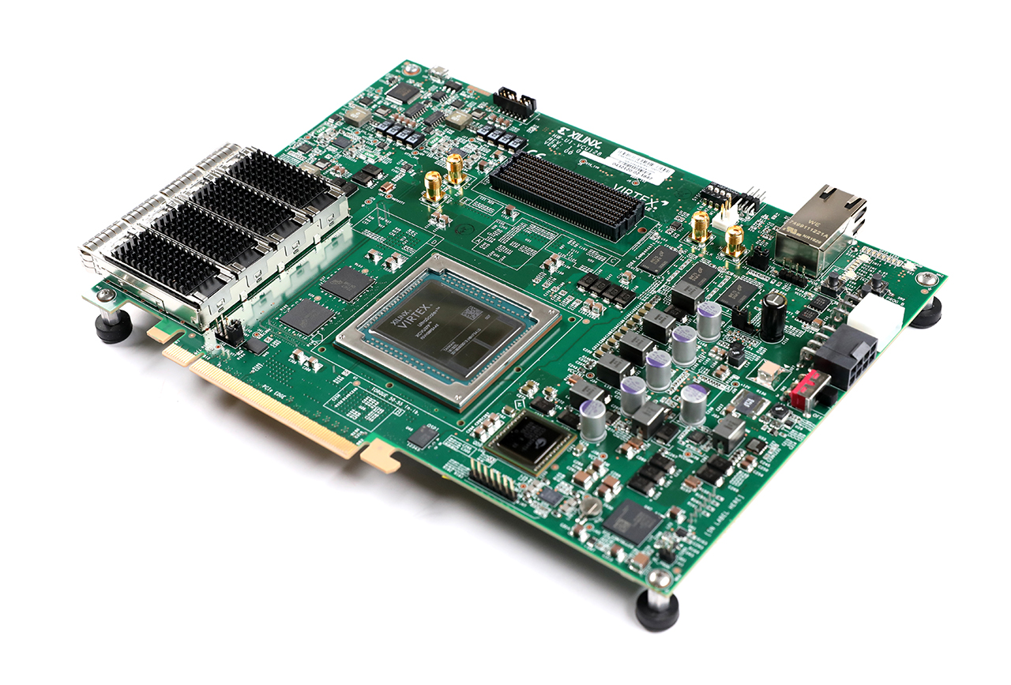
Contribution #4 – Amazingly Good Results on FPGA
We implemented our accelerator on a Xilinx VCU 128 FPGA and show that even in FPGA emulation, we beat a state-of-the-art NVidia V100:
by 4X in performance
by 2.75X in energy efficiency

Slide 10
Outline
Introduction and Motivation
Software-Level Design and Optimizations
  Cell Level Reduction for Intermediate Variables
  BP Layer Length Reduction
Hardware-Level Design and Optimizations
Evaluation
Related Work
Conclusion
Notes:
This is the outline of the rest of our talk. Next, I am going to discuss our software- and then hardware design strategies and optimizations; following that, I will demonstrate the key evaluation results and then conclude my talk.

Slide 11
Key Observation I
Dense Data
FW-GEMM
FW-EW
BP-EW
BP-GEMM
Intermediate
FW-GEMM
FW-EW
BP-EW1
BP-EW2
BP-GEMM
Notes:
We have a key observation on the intermediate data.
We find that the intermediate data between the FW cell and BP cell is dense
But some BP element wise computation only requires the data from the forward cell

Slide 12
Key Observation I
Dense Data
FW-GEMM
FW-EW
BP-EW
BP-GEMM
Intermediate
FW-GEMM
FW-EW
BP-EW1
BP-EW2
BP-GEMM
BP-EW1
Sparse Data
Notes:
And these parts actually generate much sparser data compared to the FW element wise output
We have key observation that

Slide 13
Before and After
After
~50%
Before
With the execution reordered, more data can be compressed
Notes:
This is the before and after for the data magnitude distribution.
The upper two lines are the distribution for the output of that partial BP computation, and the lower two lines represent the data distribution for vanilla intermediate variables between the fw and bp procedure.
We can see that when threshold is small, there is around a 50% sparsity difference.
So BP’s computation actually provides a better opportunity to compress the data movement.

Slide 14
Cell Level Reduction for Intermediate Variables
Moving partial bp execution from Backpropagation to forward propagation
Applying Zero-Pruning Compression
Skipping BP computation
Data Compression + Computation Skipping
Notes:
Therefore, we propose our cell level reduction which contains
- Moving forward partial BP execution that requires only the forward variables.
- Applying zero-pruning compression on those executions and save both value and index into the DRAM
- And since the input data becomes sparse, the partial computation of the remaining BP processing can be skipped using index information
In summary, with reordering, not only the data gets compression but also the computation gets reduced. Both are good for performance and energy of LSTM training

Slide 15
Outline
Introduction and Motivation
Software Level Optimizations
  Cell Level Reduction for Intermediate Variables
  BP Layer Length Reduction
Hardware Level Optimization
Evaluation
Related Work
Conclusion
Notes:
In addition to cell level reduction we propose to reduce the BP layer length

Slide 16
Key Observation II
BP Cells
Weight
Single loss
Per-timestamp loss
Importance of the cell computation is different.
Some cells make trivial contribution.
Notes:
We have another key observation that the contribution to cell computation is different across cells. In other words, there are some cells are more important than the others. The importance is evaluated by the weight gradients contributions, because all BP cells in the same layer contribute to update the same weight matrices.
The left and right line figure demonstrates the weight gradients magnitude change for different cells at the same LSTM layer.
The trend is either decreasing or increasing, it all related to how the loss is calculated and passed.
But just superficially looking at the figure, some cells contribute nearly nothing to the weight update, like the cell no.60 – 0 in the single loss one and the no.80 – 50 in the per-timestamp loss case

Slide 17
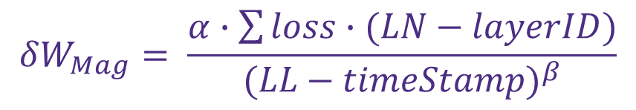
Insignificant BP Cell prediction
Total Layer Number
Current Layer ID
Mag Factor
Threshold
$$δW_{Mag}= \frac{α∙\sum{loss∙(LN−layerID)}}{{(LL−timeStamp)}^{β}}$$
Predict Weight Mag
If Significant?
Loss Type Factor
Total Layer Length
Current Cell Location
Notes:
Since we find some cells are trivial, we can identify them and skip them
In order to identify those trivial cells, we build a mathematical model.
Which takes in the LSTM layer config and final loss type into consideration.
With this model, we can set a threshold to determine whether the cell is significant
So this is the diagram for the BP cell skipping
We only need the weight gradients from the significant BP cells
And we further scale the partial results to get the gradients results for entire LSTM layer

Slide 18
Outline
Introduction and Motivation
Software Level Optimizations
  Cell Level Reduction for Intermediate Variables
  BP Layer Length Reduction
Hardware Level Optimizations
Evaluation
Related Work
Conclusion
Notes:
Next, we further propose several hardware-level design and optimizations.

Slide 19
Design Challenges
Workload
FW cell =
GEMM
+
Element-Wise
GEMM
BP cell =
GEMM
+
Element-Wise
>>
Element-Wise
Multiplier +
Accumulator
Multiplier +
Adder +
Activation Function Unit
Different Logic Design
If putting into separate modules, low logic utilization for element-wise module
If designing PEs enable both kernels ➔ low logic utilization, and high area overhead
Inefficient for fast data consumption
between two kernels
Notes:
The hardware design should be sticked with the computation
Based on our previous discussion, the computation of FW cell and BP cell can be divided into gemm and element-wise kernels.
However, these two kernels perform different computations. Note that the accumulator and adder are actually different in terms of the logic design
Besides, these two kernels have different workload. Which is gemm much larger than element-wise
So the problem is that if we put these two kernels into separate modules, which is actually popular for LSTM inference accelerator design, the element-wise kernel will be in idle for the most of the time
But if we conduct the naïve design to put all things into same PE sets, then the PE design will be complicated, but a lot of the logic still in idle and design area become large.
Besides, such design requires one kernel finished before another kernel is executed, just like GPU, so the intermediate data between these two kernel may need to be stored into DRAM, which induce data movement overhead

Slide 20
Opportunity – Adder-Based Accumulator
Idea: How to reduce the PE design cost for implement adder and accumulator?
Problem: Adder has latency to produce results, causing stalls during accumulation.
Solution: By appending a buffer after the adder, it can act like an accumulator to perform streaming accumulation.
Notes:
We address the challenges from the angle of trying to reuse the logic for adder and accumulator. So that the logic utilization can be improved, and the PE can become more flexible to serve different execution.
The problem is that adder has latency to produce results. If we perform A+B+C+… we need to wait for A+B’s result then calculate +C
We solute such problem by appending a buffer or a queue after the adder, and control the execution flow to form the streaming processing like the way illustrated in the table

Slide 21
η-LSTM Architecture with Omni-PE
Omni-PE: Enable Major LSTM Execution w/ Low Area Overhead and High Logic Utilization
Omni-PE
Channel: Omni-PEs + Activation Module
η-LSTM Architecture:
Dynamic channel function swing
Support computation Skip
η-LSTM Architecture
Notes:
This is our Omni-PE design, which enables nearly all the ,LSTM training execution, except the activation functions, w/ pretty low area overhead and potentially high logic utilization, so the design efficiency is quite high.
We have channels to hold multiple PEs and activation module. And Channel is exactly the level to switch the functionality to server different kernels.
This is our entire accelerator architecture.
Specifically, we have customized controller to enable dynamic channel function swing. So different channels could perform different kernels based on demand. All the computation resource can be leveraged and the intermediate data can be fast consumed as well.
We also customized our DMA to support the computation skipping from our software optimizations

Slide 22
Outline
Introduction and Motivation
Software Level Optimizations
  Cell Level Reduction for Intermediate Variables
  BP Layer Length Reduction
Hardware Level Optimization
Evaluation
Related Work
Conclusion
Notes:
I have talked about our optimizations, it is the time to show how effective they are.

Slide 23
Experimental Setup
GPU - Nvidia Tesla V100 (Baseline and Software Implementation)
  5,120 Shading Units @ 1230MHz
  L1 cache/ Shared Memory: 128KB * 80
  Default Memory: 32GB HBM w/ 897GB/s Bandwidth
Accelerator Implementation – Xilinx Vertex-UltraScale+ HBM VCU128 FPGA Evaluation Board
  2,852K System Logic Cells
  9,024 DSP Slices
  Memory: 8GB HBM w/ 224GB/s Bandwidth (only use 40 channels)
Benchmark
Name | Abbr.
TREC-10 | Question Segmentation
PTB | Language Modeling
IMDB | Sentiment Analysis
Name | Abbr.
WAYMO | Autonomous Driving
WMT | Machine Translation
BABI | Question Answering
Notes:
We used the latest GPU to conduct the baseline case and the pure software implementation
Our hardware design was performed on the Xilinx VCU 128 FPGA board
We evaluated six most popular LSTM benchmark

Slide 24
Improvement on Performance Speedup
Software Level Optimization achieves an average of 1.56x Speedup (Up to 1.79x)
Hardware Level Optimization achieves an average of 1.42x Speedup (Up to 1.85x)
Together, η-LSTM achieves an average of 3.99x Speedup (Up to 5.73x)
Notes:
This figure shows the effectiveness of our optimizations on the LSTM training.
We observe that our software optimization can achieve on average 1.56x and up to 1.79x speedup on GPU
Our Hardware design achieves on average 1.42x and up to 1.85x compared with baseline GPU
And combine them, we can achieve on average 3.99x and up to 5.73x speedup

Slide 25
Energy Savings
Software Level Optimization achieves an average of 1.54x Energy Saving (Up to 1.78x)
Hardware Level Optimization achieves an average of 1.67x Energy Saving (Up to 2.69x)
Together, η-LSTM achieves on an average of 2.75x Energy Saving (Up to 4.25x)
Notes:
Our optimizations also achieve great improvement for energy.
Our software level optimizations achieves on average 1.54x (up to 1.78x) on energy saving
Our Hardware level optimizations achieves on average 1.67x (up to 2.69x) on energy saving
Together, the n-LSTM achieve on average 2.75x (up to 4.25x) on energy saving

Slide 26
Improvement on Data Movement
TREC10
PTB
IMDB
WAYMO
WMT
BABI
η-LSTM’s software-level design can significantly reduce the data movement for weights, activations, and intermediate variables.
Notes:
These figures show that Our eta-lstm can effectively reduce the data movement for weights , activations, and intermediate variable

Slide 27
Improvement on Memory Footprint
TREC10
PTB
IMDB
WAYMO
WMT
BABI
Our η-LSTM can also effectively reduce the Memory Footprint for Activations and Intermediate variables.
Notes:
We further evaluate the eta-LSTM impact on the memory footprint. As shown in this figure, activation data and intermediate variables get reduced a lot

Slide 28
Related Work
Neural Network Acceleration
  CNN Training Optimization [M. Rhu et al., MICRO2016] [L. Wang et al., PPoPP2018]
  LSTM Inference Optimization [S. Han et al., FPGA 2017] [C. Gao et al., FPGA2018]
Memory Footprint Reduction
  Weight Matrix Encoding [Y. Zhao et al., ISCA2020]
  Re-computation [B. Zheng et al., ISCA2020]
η-LSTM is the first work aims to enable highly efficient large LSTM training by leveraging several unique LSTM training features to drastically reduce memory footprint and data movement.
Notes:
There are many works focusing on NN acceleration, But most of them are for CNN and LSTM inference. Since LSTM training Is very different from CNN and LSTM inference, their solution can hardly address our problems.
There are also memory footprint reduction works, they propose the weight matrix compression and re-computation schemes. But Memory footprint problem of LSTM training comes from the intermediate variables, compressing the weight can hardly reduce the intermediate variables. On the other hand, it is costly to recompute these intermediate variable for LSTM training, making re-computation scheme not appropriate for LSTM training.
Our work here is the first work to accelerate the large LSTM training, and leverages UNIQUE LSTM training feature to reduce the memory footprint and data movement.

Slide 29
Conclusion
We conduct a comprehensive characterization study for large LSTM training on state-of-the-art architectures and identify its root causes for training inefficiencies.
At software level, we introduce several key observations regarding the unique LSTM training data patterns, which are then leveraged to enable large reduction on memory footprint, data movements and training latency.
At hardware level, we propose novel architecture designs to enable high logic utilization on customized NPUs, while supporting our software-level optimizations and further enhancing LSTM training performance and energy efficiency.
Our proposed η-LSTM outperforms the baseline GPU by an average of 3.99x on performance and 2.75x on energy consumption, even when emulated in FPGA!
Notes:
To conclude this talk. Balabala~

Slide 30

η-LSTM: Co-Designing Highly-Efficient Large LSTM Training via Exploiting Memory-Saving and Architectural Design Opportunities
Xingyao Zhang^{1,2}, Haojun Xia³, Donglin Zhuang³, Hao Sun³, Xin Fu¹, Michael Taylor², and Shuaiwen Leon Song³
1. ECOMS Lab, University of Houston
2. Bespoke Silicon Group, University of Washington
3. FSA Lab, University of Sydney
(xingyaoz@cs.washington.edu)

Slide 31
Acknowledgements
This work was partially supported by Air Force Research Laboratory (AFRL) and Defense Advanced Research Projects Agency (DARPA) under agreement number FA8650-18-2-7863, and by the DARPA/SRC JUMP ADA Center. This research was also partially supported by Facebook Faculty Award and University of Sydney faculty startup funding, Australia Research Council (ARC) Discovery Project DP210101984. This research was also partially supported by NSF grants CCF-1900904, CCF-1619243, and CCF-1537085 (CAREER).

