Slide 1
TimeCube
A Manycore Embedded Processor with
Interference-agnostic Progress Tracking
Anshuman Gupta
Jack Sampson
Michael Bedford Taylor
University of California, San Diego

Slide 2
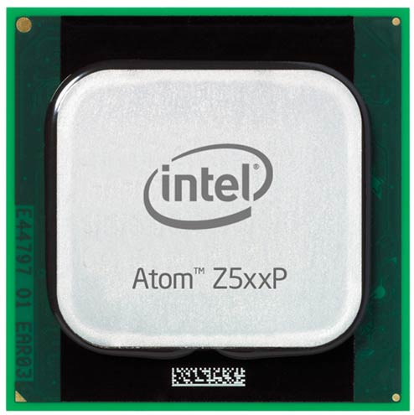
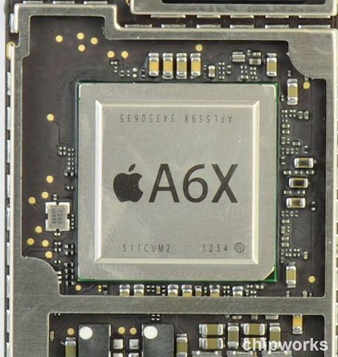

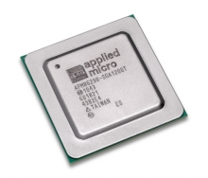
Multicore Processors in Embedded Systems
Intel Atom
Apple A6
Qualcomm
Snapdragon
Applied Micro
Green Mamba
Standard in domains such as smartphones
  Higher Energy-Efficiency
  Higher Area-Efficiency
Notes:
Evident form the ever increasing number of low-power commercial multi-core processors being offered

Slide 3
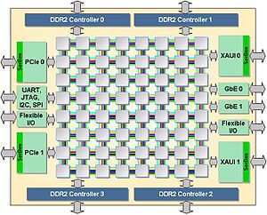
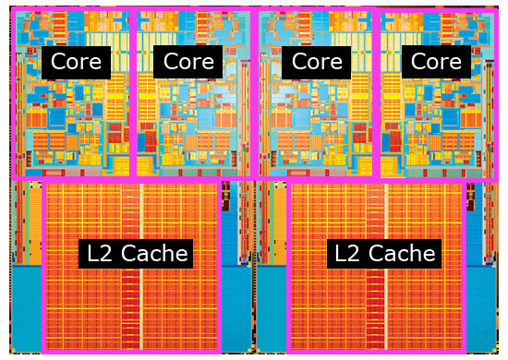
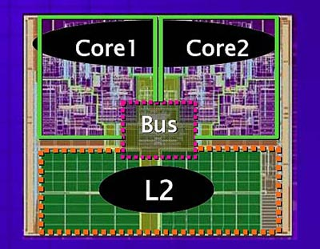
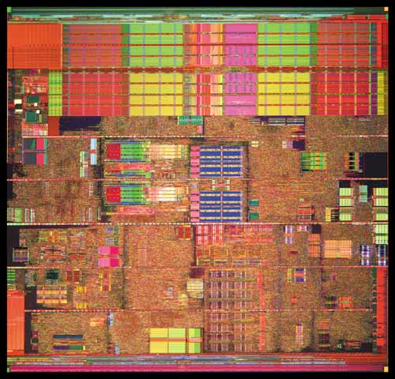
Towards Manycore Embedded Systems
Unicore
Dualcore
Shared Mem
Quadcore
Shared Cache,
Shared Mem
Many(64)core
Shared OCN,
Shared Cache,
Shared Mem etc.
Number of cores in a processor is increasing
So is sharing!

Slide 4
What’s Great About Manycores
Lots of resources
Cores
Caches
DDR channels
Memory Bandwidth
Tile GX 8072
72
23MB
4
100GB/s
Xeon Phi 7120X
61
30.5MB
16
352GB/s
Notes:
1T = 64*8 bits = 64 bytes
1600MT = 1600 * 64 MB
= 100 GB

Slide 5
What’s Not So Great: Sharing
Low per-core resources
Cache / core
Memory BW / core
Tile Gx 8072
327 KB
1.16 B/cyc
Intel Xeon 4650
2.5 MB
4.26 B/cyc
> 7X
> 3X
The applications fight with each other over
the limited resources.

Slide 6
Sharing at its Worst
SPEC2K, SPEC2K6
+ I/O-centric suite
32 cores, 16 MB L2 Cache, 96Gb/s DRAM bandwidth, 32GB DDR3
12X worstcase slowdowns!
Notes:
State-of-the-art softwares (OS) unable to sufficiently reduce interference

Slide 7
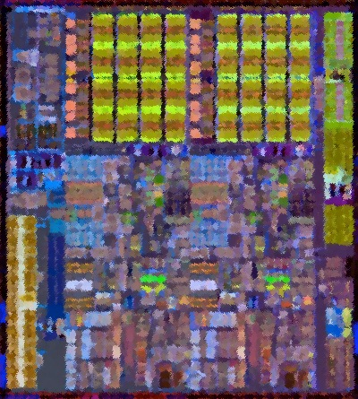
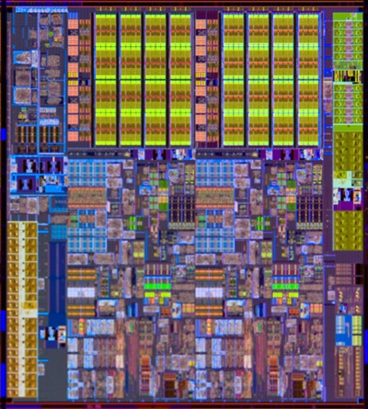


Key Problems With Sharing
I know how I’d run by myself, but how much are others slowing me down?
How do I get guarantees of how much performance I’ll get?
How do we allocate the resources for the good of the many, but without punishing the few, or the one?
! ! !

Slide 8
I know how I’d run by myself, but how much are others slowing me down?
Solution: We introduce a new metric –
Progress-Time
This Paper: With the right hardware, we can calculate the Progress-Time in real time.
Useful Because: Key building block for the hardware, for the operating system, and for the application to create guarantees about execution quality.
Time the application would have taken, were it to have been allocated all CPU resources.
Notes:
Appear

Slide 9
How do I get guarantees of how much performance I’ll get?
Solution: We introduce a new hardware-generated data structure –
Progress Tables
– and we extend the hardware to dynamically partition resources.
This Paper: With a little more hardware, we can compute the Progress Tables accurately and accordingly partition resources to guarantee performance, in real time.
Useful Because: We can determine exactly how much resources are required to attain a given level of performance.
For each application, how much Progress-Time it gets for every possible resource allocation
Notes:
Appear

Slide 10
Sneak Preview
specrand
Graphical images of real Incremental Progress Tables generated in real time by our hardware
Red = attaining the full 1ms of Progress-Time in 1ms of real time
hmmer
astar
Notes:
Scale units are ms
Fix font size
Fix positioning of the graphs
Can extend with more dimensions in Ptables to handle more resource types

Slide 11
How do we allocate the resources for the good of the many, but without punishing the few, or the one*?
Solution: We introduce a new hardware-generated data structure –
SPOT (Simultaneous
Performance
Optimization Table)
This Paper: With 3% more hardware, we can find near-optimal resource allocations, in real time.
Useful Because: Greatly improve system performance and fairness.
For each application, how much resources should be allocated to maximize geomean of Progress-Times across the system.
* Star Trek reference.

Slide 12
TimeCube: A Demonstration Vehicle for These Ideas
Scalable manycore architecture, in-order memory system
Critical resources spatially distributed over tiles
Notes:
Applications execute concurrently using shared last-level cache, memory bandwidth and DRAM banks
Multiple memory channels shared between applications

Slide 13
Outline
Introduction
Measuring Execution Quality: Progress-Time
Enforcing Execution Guarantees: Progress-Table
Allocating Execution Resources: SPOT
Conclusion

Slide 14


Measuring Execution Progress: Progress-Time
What do we need to compute Progress-Time?
Current Universe
Ideal (Shadow) Universe

Slide 15
Measuring Execution Progress: Progress-Time
What do we need to compute Progress-Time?
Last Level Cache
Memory Bandwidth
DRAM Banks
Execution Counters
Current Universe
Ideal (Shadow) Universe

Slide 16
Measuring Execution Progress: Progress-Time
What do we need to compute Progress-Time?
Last Level Cache
+
Shadow Cache
+
Memory Bandwidth
Shadow Prefetcher
+
DRAM Banks
Shadow Banking
Execution Counters
+
Shadow Counters
Current Universe
Ideal (Shadow) Universe

Slide 17
Shadow Structures
Shadow Tags
  Measure cache miss rates for full cache allocation
  Set-sampling reduces overhead
Shadow Prefetchers
  Measure prefetches issued and prefetch hit rate
  Track cache miss stream from Shadow Tags
  Launch fake prefetches, no data buffers
Shadow Banking
  Measure DRAM page hits, misses, and conflicts
  Tracks current state of DRAM row buffers using DDR protocol

Slide 18
A Shadow Performance Model for Progress-Time
Analytical model to estimate Progress-Time
  Takes into account the critical memory resources
  Assumes no change in core pipeline execution cycles
  Uses events collected from the shadow structures
  Reuses average latencies for accessing individual resources
_{Shadow Events} | Average Latencies for current allocation
L2Hit | x L2HitLatency
PrefHit | x PrefHitLatency
PageHit | x PageHitLatency
PageMiss | x PageMissLatency
PageConflict | x PageConflictLatency
ExecutionTime = corecycles +
Notes:
Progress-Time for all possible resource allocations estimated
Progress-Time Tables stored on application cores
Progress-Time estimation done on application core

Slide 19
Accounting for Bandwidth Stalls
L2 misses and prefetcher statistics determine required bandwidth
No bandwidth stall assumed if sufficient bandwidth
If insufficient bandwidth, performance (IPC) degrades proportionally
Notes:
Memory requests assumed to be uniformly randomly distributed
Progress-Time Table entries filled with scaled execution times

Slide 20
Evaluation Methodology
Evaluate a 32-core instance similar to modern manycore processors
26 benchmarks from SPEC2K, SPEC2K6, and an I/O-centric suite
Near unlimited combinations of simultaneous runs
Compress run-space by classifying apps into streams, cliffs, and slopes based on cache sensitivity

Slide 21
Shadow Performance Model and Shadow Structures Accurately Compute Progress-Time
99%
TimeCube tracks Progress-Times with ~1% error
No latency overheads
Notes:
Ptables can be reliably used for resource management

Slide 22
Outline
Introduction
Measuring Execution Quality: Progress-Time
Enforcing Execution Guarantees: Progress-Table
Allocating Execution Resources: SPOT
Conclusion

Slide 23
Progress-Tables in TimeCube
One Progress-Table (Ptable) per application
Memory bandwidth binned in 1% increments
Last-level cache arrays allocated in powers of two
Progress-Time accumulated over intervals using last cell
Notes:
DRAM banks are statically partitioned

Slide 24
Shadow Structures 2.0
Shadow Tags
  Measure cache miss rates for all power-of-two cache allocations
  LRU-stacking reduces overhead
Shadow Prefetchers
  Add one instance for each cache allocation
Shadow Banking
  Add one instance for each cache allocation
Same performance model is used as for Progress-Time.

Slide 25
Progress-Tables Examples
specrand
Ptables provide accurate mapping from resource allocation to slowdown
TimeCube can use these maps to guarantee QoS for applications
Overall as well as per-interval QoS control
hmmer
astar

Slide 26
Outline
Introduction
Measuring Execution Quality: Progress-Time
Enforcing Execution Guarantees: Progress-Table
Allocating Execution Resources: SPOT
Conclusion

Slide 27
Allocating Execution Resources: SPOT
Key Idea: Run optimization algorithm over application Progress-Tables to maximize an objective function
Objective Function: Mean Progress-Times of all applications, accumulated over all intervals so far and the upcoming one
Geometric-Mean balances throughput and fairness
The geomean can be approximated to:

Slide 28
Implementation: Maximizing the
Mean Progress-Time
Bin-packing: Distribute resources among applications to maximize mean
Clever algorithm allows optimal solution in pseudo-polynomial time
<All,All,All> corner gives maximum mean and corresponding allocation
Notes:
Dynamic programming based algorithm to maximize the mean

Slide 29
Real-Time TimeCube Resource Allocation
Interval-based TimeCube execution
Statistics collected during execution
Every interval :
  Estimate Progress-Times
  Allocate resource partitions
  Reconfigure partitions
Done in parallel with execution

Slide 30
Progress-Based Allocation Improves Throughput
77%
36%
Allocating resources simultaneously increases throughput
As much as 77% increase, 36% improvement on average
Notes:
Lack of global information leads to allocation with conflicting objectives

Slide 31
Maximizing Geometric Mean Provides Fairness
57%
19%
Worstcase performance improves by 19% on average
As much as 57% worstcase improvement
Notes:
Maximizing geometric mean increases fairness
Maximizing arithmetic mean is not so fair

Slide 32
TimeCube’s Mechanisms are Energy-Efficient
Progress-Time Mechanisms consume < 0.5% energy
  Shadow structures consume 0.23%
  Ptable calculation consumes just 0.01%
  SPOT calculation consumes 0.18%

Slide 33
TimeCube’s Mechanisms are Area-Efficient
Progress-Time Mechanisms consume < 7% area
  Shadow Tags consume 1.40%
  Ptables consume 1.11%
  SPOT consumes 3.20%

Slide 34
Related Work
Measuring Execution Quality [Progress-Time]
  Analytical: Solihin [SC’99], Kaseridis [HPCA’10]
  Regression: Eyerman [ISPASS’11]
  Sampling: Yang [ISCA’13]
Enforcing Execution Guarantees [Progress-Tables]
  RT systems: Lipari [RTTAS’00], Bernat [RTS’02], Beccari [RTS’05]
  Offline: Mars [ISCA’13], Federova [ATC’05]
Allocating Execution Resources [SPOT]
  Adaptive: Hsu [PACT’06], Guo [MICRO’07]
  Offline: Bitirgen [MICRO’08], Liu [HPCA’04]

Slide 35
Conclusions
Problem: Interference on multicore processors can lead to large unpredictable slowdowns.
How to measure execution quality: Progress-Time
  We can track live application progress with high accuracy (~ 1% error) and low overheads (0.5% performance, < 0.5% energy, < 7% area).
How to enforce execution guarantees: Progress-Tables
  We can use Progress-Tables to precisely control the QoS provided, on-the-fly.
How to allocate execution resources: SPOT
  We can use SPOT to improve both throughput and fairness (36% and 19% on average, 77% and 57% in best-case).
Multicore processors can employ these three mechanisms, demonstrated through TimeCube, to make them more attractive for embedded systems.
Notes:
Overheads: < 0.5% performance, < 0.5% energy, < 7% area

Slide 36
Thank You
Questions?

Slide 37
Backup Slides

Slide 38
Problem: Resource Sharing Causes Interference
Unpredictable slowdown during concurrent execution
Can lead to failed QoS guarantees
Notes:
Slowdowns on a modern Intel Quad-core system
Some embedded systems need to ensure QoS

Slide 39
Progress-Tables
Progress-Time for a spectrum of resource allocations
Provide information for resource management at the right granularity

Slide 40
Dynamic Execution Isolation Reduces Interference
TimeCube partitions shared resources for dynamic execution isolation
Last-Level Cache Partitioning
  Associative Cache Partitioning allocates cache ways to applications
  Virtual Private Caches [Nesbit ISCA 2007]
Memory Bandwidth Partitioning
  Memory bandwidth is dynamically allocated between applications
  Fair Queuing Arbiter [Nesbit MICRO 2006] for memory scheduling
DRAM Capacity Partitioning
  DRAM memory banks are split between applications
    Row buffers fronting these banks are also partitioned as a result
  OS page management maintains physical memory bank allocation

Slide 41
Prefetcher Throttling Increases Bandwidth Utilization
Filter fixed ratio of prefetches based on aggression level, such that required BW just above allocated BW
Shadow Performance Model augmented to give required BW

Slide 42
Prefetcher Throttling Chooses the Right-Level
Nine Aggression-Levels used
Throttler chooses the right level to give pareto-optimal curve
Prefetcher throttling efficiently utilizes the available bandwidth
Notes:
No throttling at low bandwidths
Full prefetching at high bandwidths

Slide 43
Prefetcher Throttling Chooses the Right-Level
Pareto-Optimal
Nine Aggression-Levels used
Throttler chooses the right level to give pareto-optimal curve
Prefetcher throttling efficiently utilizes the available bandwidth
Notes:
No throttling at low bandwidths
Full prefetching at high bandwidths

Slide 44
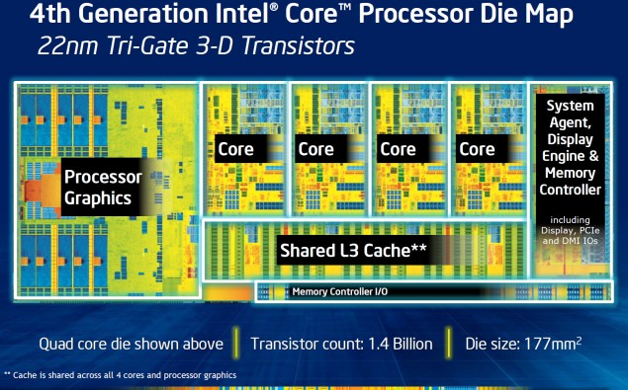
Multicore Processors Share Resources
Low-Power
Intel “Haswell”
Architecture
Leads to increased utilization
Lower per core resources on manycore processors
Increasing pressure to share resources

Slide 45
* * *

Slide 46
Shadow Performance Model and Shadow Structures Accurately Compute Progress-Time
TimeCube tracks Progress-Times with ~1% error
Performance overheads due to reconfiguration are < 0.5%
Notes:
Ptables can be reliably used for resource management

Slide 47
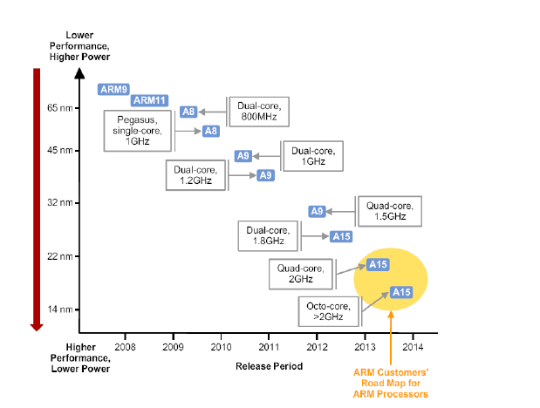
Towards Manycore Embedded Systems
Notes:
Samsung hinting about launching an Octa-core Exynos processor based system this year
Use Tilera processors roadmap

Slide 48
Objective: Maximizing Mean Progress-Time
TimeCube allocates resources between applications to maximize the Mean Progress-Times
  Geometric-Mean balances throughput and fairness
The geometric mean can be approximated to:
Notes:
Arithmetic mean gives higher throughput, but poor fairness
Harmonic Mean increases fairness, but poor throughput
Additive formulation for more applications than cores

Slide 49
Measuring Execution Progress: Progress-Time
What do we need to compute Progress-Time?
Dynamic Execution
Isolation
Shadow Performance Modeling
Last Level Cache
Shadow Cache
Execution
Stats
Memory Bandwidth
Shadow Prefetcher
DRAM Banks
Shadow Banking
Current Universe
Ideal (Shadow) Universe
Notes:
Google beach pictures

Slide 50
Solution: Track Live Application Progress
Determine and control QoS provided to applications “online”
We quantify application progress using Progress-Time:
Progress-Time is the amount of time required for an application to complete the same amount of work it has done so far, were to have been allocated all CPU resources.
Notes:
Represents interference-agnostic application progress
Multicore counterpart of CPU-time for tracking progress

Slide 51
TimeCube: A Progress-Tracking Processor
TimeCube is a manycore processor
Augmented to track & use live Progress-Times
Embedded domains can use TimeCube to guarantee QoS
Notes:
Mention that we don't know w1, w2
Mention goodness of results and their affects, so if people leave at this time, they still get it.
All multicore benefits

Slide 52
TimeCube Periodically Estimates Progress-Times
Concurrent execution on dynamically isolated resources
  Dynamically partition critical shared resources
  Fine-grained QoS control
Shadow performance model estimates Progress Time
  Uses execution statistics
  Statistics from shadow structures
Progress-Time estimates used for shared resource management
Notes:
Resource Isolation removes resources interference only

Slide 53
TimeCube Periodically Estimates Progress-Times
Concurrent execution on dynamically isolated resources
  Dynamically partition critical shared resources
  Fine-grained QoS control
Shadow performance model estimates Progress Time
  Uses execution statistics
  Statistics from shadow structures
Progress-Time estimates used for shared resource management

Slide 54
TimeCube Periodically Estimates Progress-Times
Concurrent execution on dynamically isolated resources
  Dynamically partition critical shared resources
  Fine-grained QoS control
Shadow performance model estimates Progress Time
  Uses execution statistics
  Statistics from shadow structures
Progress-Time estimates used for shared resource management

Slide 55
Isolation Can’t Remove Performance Interference
Isolation removes resources interference only
  Performance not linearly related to resource allocation
  Same resource allocations can lead to different performance
TimeCube uses Shadow Performance Modeling to estimate performance impact of different resource allocations

Slide 56
Prefetcher Throttling Chooses the Right-Level
Pareto-Optimal
Nine Aggression-Levels used
Throttler chooses the right level to give pareto-optimal curve
Prefetcher throttling efficiently utilizes the available bandwidth
Notes:
No throttling at low bandwidths
Full prefetching at high bandwidths

