Slide 1


Kismet:
Parallel Speedup Estimates for Serial Programs
Donghwan Jeon, Saturnino Garcia, Chris Louie, and Michael Bedford Taylor
Computer Science and Engineering
University of California, San Diego
Attain Their Inner Speedup
Helping Serial Programs
Notes:
Hi, my name is Donghwan Jeon.
I am going to present Kismet, parallel speedup estimates for serial programs.
This work is done with my colleagues Sat and Chris, and with my advisor Michael Taylor.

Slide 2




Questions in Parallel Software Engineering
I heard about these new-fangled multicore chips.
How much faster will PowerPoint be with 128 cores?
We wasted 3 months for 0.5% parallel speedup.
Can’t we get parallel performance estimates earlier?
How can I set the parallel performance goals
for my intern, Asok?
Dilbert asked me to achieve 128X speedup.
How can I convince him it is impossible
without changing the algorithm?
Notes:
As multi-core processors enter the mainstream computing, there is increasing interest in parallelization.
Let’s look at the types of questions people are asking about parallelization in a hypothetical company that might be familiar to you.
The boss might say with excitement: “…”
But the project manager is skeptical about parallelization: “…”
The Senior engineer, Dilbert, is wondering how he can set the performance target for his intern.
Finally, our intern Asok – we know interns are the smartest in any company – is asked to achieve 128X speedup.But since he is smart, he knows it is impossible without changing the core algorithm,
But he does not know how to convince his boss.
These questions are pretty common because parallelization is often challenging and time-consuming, but the benefit is unpredictable.

Slide 3
Kismet Helps Answer These Questions
Kismet automatically provides
the estimated parallel speedup upperbound
from serial source code.
1. Produce instrumented binary
with kismet-cc
$> make CC=kismet-cc
$> $(PROGRAM) $(INPUT)
$> kismet –opteron -openmp
Cores 1 2 4 8 16 32
Speedup 1 2 3.8 3.8 3.8 3.8
(est.)
2. Perform parallelism profiling
with a sample input
3. Estimate speedup
under given constraints
Kismet’s easy-to-use usage model
Notes:
Make bottom box a little bit bigger
This is exactly what Dilbert and Asok need to use.

Slide 4

Kismet Overview
Kismet
Serial
Source
Code
Hierarchical
Critical Path
Analysis
Parallelization
Planner
Parallelism
Profile
Find the best
parallelization
for the
target machine
Sample
Input
Measure
parallelism
Speedup
Estimates
Parallelization
Constraints
Kismet extends critical path analysis to incorporate
the constraints that affect real-world speedup.
Notes:
This figure overviews Kismet system.
As we saw in the usage model of Kismet,
Kismet accepts serial source code and sample input,
then profiles the parallelism from the serial execution of the program.
Once the parallelism profile is available,
Parkour’s parallelization planner incorporates other considerations –
exploitability, overhead, and resource constraints,
and then reports the speedup estimates.
Parkour extends critical path analysis
to incorporate other key considerations in parallelization.

Slide 5
Outline
Introduction
  Background: Critical Path Analysis
  How Kismet Works
Experimental Results
Conclusion
Notes:
12:45
Now I’m going to talk about critical path analysis which Parkour extends,
and then show how parkour works with an example,
and then present the experimental results.
Let’s examine critical path analysis.

Slide 6
The Promise of Critical Path Analysis (CPA)
Definition: program analysis that computes the longest dependence chain in the dynamic execution of a serial program
Typical Use: approximate the upperbound on parallel speedup without parallelizing the code
Assumes: an ideal execution environment
  All parallelism exploitable
  Unlimited cores
  Zero parallelization overhead

Slide 7
How Does CPA Compute Critical Path?
la $2, $ADDR
load $3, $2(0)
addi $4, $2, #4
store $4, $2(4)
store $3, $2(8)
Notes:
Show equation first and show the parallelism number 2.6

Slide 8
How Does CPA Compute Critical Path?
la $2, $ADDR
1
load $3, $2(0)
addi $4, $2, #4
1
4
store $4, $2(4)
store $3, $2(8)
1
1
node: dynamic instruction with latency
Notes:
Show equation first and show the parallelism number 2.6

Slide 9
How Does CPA Compute Critical Path?
la $2, $ADDR
1
load $3, $2(0)
addi $4, $2, #4
1
4
store $4, $2(4)
store $3, $2(8)
1
1
node: dynamic instruction with latency
edge: dependence between instructions
Notes:
Show equation first and show the parallelism number 2.6

Slide 10
How Does CPA Compute Critical Path?
la $2, $ADDR
1
work = 8
load $3, $2(0)
addi $4, $2, #4
1
4
store $4, $2(4)
store $3, $2(8)
1
1
node: dynamic instruction with latency
edge: dependence between instructions
work: serial execution time,
total sum of node weights
Notes:
Show equation first and show the parallelism number 2.6

Slide 11
How Does CPA Compute Critical Path?
la $2, $ADDR
1
work = 8
load $3, $2(0)
cp = 6
addi $4, $2, #4
1
4
store $4, $2(4)
store $3, $2(8)
1
1
node: dynamic instruction with latency
edge: dependence between instructions
work: serial execution time,
total sum of node weights
critical path length (cp):
minimum parallel execution time
Notes:
Show equation first and show the parallelism number 2.6

Slide 12
How Does CPA Compute Critical Path?
la $2, $ADDR
1
work = 8
load $3, $2(0)
cp = 6
addi $4, $2, #4
1
4
store $4, $2(4)
store $3, $2(8)
1
1
Total-Parallelism
= 1.33
node: dynamic instruction with latency
edge: dependence between instructions
work: serial execution time,
total sum of node weights
work
critical path length (cp):
minimum parallel execution time
Total-Parallelism =
critical path length
Notes:
Show equation first and show the parallelism number 2.6

Slide 13
Total-Parallelism Metric:
Captures the Ideal Speedup of a Program
Min 1.0
Total-Parallelism
Totally
Serial
Highly Parallel
Most work
off the critical path
All the work
on the critical path
……
……
Notes:
What does parallelism metric mean?
It captures the ideal speedup of a program.
As it represents speedup, the minimum value is 1.0.
A program with parallelism 1.0 looks like a long chain
Where all the work is on the critical path of the graph.
When a program’s parallelism is high, the graph looks very different.
It is fat and most work is off the critical path.

Slide 14
Why CPA is a Good Thing
Works on original, unmodified serial programs
Provides an approximate upperbound in speedup, after applying typical parallelization transformations
  e.g. loop interchange, loop fusion, index-set splitting, …
Output is invariant of serial expression of program
  Reordering of two independent statements does not change parallelism
Notes:
Let me tell you why CPA is a good thing.

Slide 15
A Brief History of CPA
Employed to Characterize Parallelism in Research
  COMET [Kumar ‘88]: Fortran statement level
  Paragraph [Austin ‘92]: Instruction level
  Limit studies for ILP-exploiting processors
  [Wall, Lam ‘92]
Not widely used in programmer-facing parallelization tools
Notes:
Due to those advantages, CPA has been employed in many research project since 1980’s.

Slide 16
Why isn’t CPA commonly used in programmer-facing tools?
Benchmark
ep
life
is
sp
unstruct
sha
Measured Speedup (16 cores)
15.0
12.6
4.4
4.0
3.1
2.1
CPA Estimated Speedup
9722
116278
1300216
189928
3447
4.8
Optimism Ratio
648
9228
295503
47482
1112
2.3
Optimism
Ratio
CPA estimated speedups do not
correlate with real-world speedups.
Notes:
Show measured speedup first, then CPA results
Sort benchmarks to make the point clearer

Slide 17
CPA Problem #1:
Data-flow Style Execution Model Is Unrealistic
void outer( )
{
….
middle();
}
void middle( )
{
….
inner();
}
void inner( )
{
….
parallel doall for-loop
reduction
}
Time
Invoke middle
Invoke inner
Difficult to map this onto
von Neumann machine and imperative programming language
Notes:
Problem with CPA, not problem of CPA
Top -> outer
Do not use “moment”, use “point” to describe the dotted lines
Revise the slide title

Slide 18
CPA Problem #2:
Key Parallelization Constraints Are Ignored
Exploitability
What type of parallelism is supported by the target platform?
e.g. Thread Level (TLP), Data Level (DLP), Instruction Level (ILP)
Resource
Constraints
How many cores are available for parallelization?
Overhead
Do overheads eclipse the benefit of the parallelism?
e.g. scheduling, communication, synchronization
Notes:
Revise title
“the key parallelization”
“the overhead”

Slide 19
Outline
Introduction
  Background: Critical Path Analysis
  How Kismet Works
Experimental Results
Conclusion
Notes:
12:45
Now I’m going to talk about critical path analysis which Parkour extends,
and then show how parkour works with an example,
and then present the challenges in Parkour.
Let’s examine critical path analysis.

Slide 20
Kismet Extends CPA to Provide Practical Speedup Estimates
Kismet
Hierarchical
Critical Path
Analysis
Parallelization
Planner
CPA
Measure parallelism
with a hierarchical
region model
Find the best
parallelization
strategy with target constraints
Notes:
11:59
As we saw in the previous slide,
CPA’s speedup estimation is overly optimistic.
Although CPA incorporates parallelism,
It does not incorporates other key considerations,
and it results in optimistic speedup estimates.
Kismet Extends CPA with key parallelization constraints.
Its hierarchical critical path analysis incorporates parallelism,
and parallelization planner takes other constraints into consideration,
achieving more accurate speedup estimation.

Slide 21
Revisiting CPA Problem #1:
Data-flow Style Execution Model Is Unrealistic
void top( )
{
….
middle();
}
void middle( )
{
….
inner();
}
void inner( )
{
….
parallel doall for-loop
reduction
}
Time
Notes:
Remove box
Make the text

Slide 22
Hierarchical Critical Path Analysis (HCPA)
Step 1. Model a program execution with hierarchical regions
Step 2. Recursively apply CPA to each nested region
Step 3. Quantify self-parallelism
for (i=0 to 4)
loop i
for (j=0 to 32)
foo ();
loop j
loop k
for (k=0 to 2)
bar1();
foo()
bar1()
bar2()
bar2();
HCPA Step 1. Hierarchical Region Modeling
Notes:
Why functions and loops? Programmer centric units
Let’s examine Hierarchical Critical Path Analysis, or HCPA.
HCPA models the execution of a program with hierarchical regions,
Capturing hierarchical program structure such as loops and functions.
Each region works as a unit of parallelization in HCPA.
In the example figure, there is one outer loop that contains two inner loops,
And each inner loop contains function calls.
In addition to hierarchically modeling the program execution,
HCPA also provides self-parallelism of each region,
which quantifies the amount of parallelism in each region.

Slide 23
HCPA Step 2: Recursively Apply CPA
Total-Parallelism from
inner()
= ~7X
Total-Parallelism from
middle() and inner()
= ~6X
Total-Parallelism from
outer(), middle(), and inner()
= ~5X
What is a region’s parallelism
excluding the parallelism from its nested regions?

Slide 24
HCPA: Introducing Self-Parallelism
Represents a region’s ideal speedup
Differentiates a parent’s parallelism from its children’s
Analogous to self-time in serial profilers
for (i=0 to 100) {
}
for (i=0 to 100) {
}
a[i] = a[i] + 1;
b[i] = b[i] -1;
a[i] = a[i] + 1;
b[i] = b[i] -1;
200X
2X
100X
Total-Parallelism
(from CPA)
Self-Parallelism
(from HCPA)
Notes:
ITALICIZE self-parallelism
So, what is self-parallelism?
To differentiate the parallelism metric used in CPA from self-parallelism,
I’ll call it total-parallelism.
As shown in the figure,
Total-parallelism represents the ideal speedup of the whole program.
In contrast, self-parallelism differentiates parent region’s parallelism from children’s
and provides localized parallelism for each region.
In this example, the parallel loop’s self-parallelism is 100x
as parallelizing the loop will bring 100x speedup in ideal case.
Each iteration’s self-parallelism is two from instruction-level parallelism.
In this regard, self-parallelism is analoguous to self-time in serial profilers such as gprof.

Slide 25
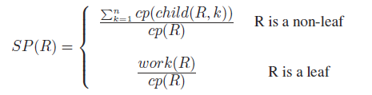
HCPA Step 3: Quantifying Self-Parallelism
for (i=0 to 100) {
}
for (i=0 to 100) {
}
for (i=0 to 100) {
}
a[i] = a[i] + 1;
b[i] = b[i] -1;
a[i] = a[i] + 1;
b[i] = b[i] -1;
a[i] = a[i] + 1;
b[i] = b[i] -1;
Self-Parallelism(Parent)
Total-Parallelism(Parent)
Total-Parallelism(Children)
Generalized Self-Parallelism Equation
Notes:
HOW DO WE IMPLEMENT
Our intuition on quantifying self-parallelism is
The relationship between total-parallelism and self-parallelism.
As this figure indicates, conceptually, self-parallelism of the parent region can be computed
from total-parallelism of parent and children regions.
The challenge is to eliminate children region’s parallelism from Parent’s total-parallelism.
No, simple arithmetic divide does not work in general cases.
Now, let’s examine how Parkour quantifies self-parallelism.

Slide 26
Self-Parallelism:
Localizing Parallelism to a Region
Self-P (inner) = ~7.0 X
Self-P (middle) = ~1.0 X
Self-P (outer) = ~1.0 X
Notes:
“the same”

Slide 27
Classifying Parallelism Type
yes
ILP
yes
DOACROSS
Leaf Region?
yes
P Bit == 1?
no
Loop Region?
no
DOALL
TLP
no
See our paper for details…

Slide 28
Why HCPA is an Even Better Thing
HCPA:
  Keeps all the desirable properties of CPA
  Localizes parallelism to a region via the
  self-parallelism metric and hierarchical region modeling
  Facilitates the classification of parallelism
  Enables more realistic modeling of parallel execution (see next slides)

Slide 29
Outline
Introduction
  Background: Critical Path Analysis
  How Kismet Works
    HCPA
    Parallelization Planner
Experimental Results
Conclusion
Notes:
12:45
Now I’m going to talk about critical path analysis which Parkour extends,
and then show how parkour works with an example,
and then present the challenges in Parkour.
Let’s examine critical path analysis.

Slide 30
Revisiting CPA Problem #2:
Key Parallelization Constraints Are Ignored
Exploitability
What type of parallelism is supported by the target platform?
e.g. Thread Level (TLP), Data Level (DLP), Instruction Level (ILP)
Resource
Constraints
How many cores are available for parallelization?
Overhead
Do overheads eclipse the benefit of the parallelism?
e.g. scheduling, communication, synchronization
Notes:
Revise title
“the key parallelization”
“the overhead”

Slide 31
Parallelization Planner Overview
Goal: Find the speedup upperbound based on
the HCPA results and parallelization constraints.
region structure
self-parallelism
Planning
Algorithm
Parallel
Execution Time
Model
Parallel
Speedup
Upperbound
HCPA profile
core count
exploitability
overhead
…
Constraints
Target-dependent
parallelization planner
Notes:
Add one more input

Slide 32
Planning Algorithm:
Allocates Cores with Key Constraints
The product
should not exceed
the available core count
for (i=0 to 4)
loop i
self-p=4.0
for (j=0 to 32)
Max 4X
loop j
foo ();
loop j
self-p=32.0
loop k
self-p=1.5
Max 32X
Max 2X
for (k=0 to 2)
bar1();
bar2();
foo()
self-p=1.5
bar1()
self-p=2.0
bar2()
self-p=5.0
1X
Max 2x
Max 2x
Max 5x
1X
1X
A sample core allocation process
Self-Parallelism
The allocated core count should not exceed ceil [self-p].
Exploitability
If a region’s parallelism is not exploitable,
do not parallelize the region.
Core Count
The product of allocated cores from the root to a leaf
should not exceed the total available core count.
Notes:
Let’s examine Hierarchical Critical Path Analysis, or HCPA.
HCPA models the execution of a program with hierarchical regions,
Capturing hierarchical program structure such as loops and functions.
Each region works as a unit of parallelization in HCPA.
In the example figure, there is one outer loop that contains two inner loops,
And each inner loop contains function calls.
In addition to hierarchically modeling the program execution,
HCPA also provides self-parallelism of each region,
which quantifies the amount of parallelism in each region.

Slide 33
Planning Algorithm:
Finding the Best Core Allocation
Estimate the execution time for each plan and
pick the one with the highest speedup.
Highest Speedup
Plan A
Plan B
Plan C
core: 4X
core: 2X
core: 2X
Speedup
14.5X
Speedup
7.2X
Speedup
3.3X
core: 8X
core: 1X
core: 4X
core: 4X
core: 16X
core: 16X
Core allocation plans for 32 cores
How can we evaluate the execution time
for a specific core allocation?
Notes:
“The planner”, “The planning algorithm” .. Note the article
Parallelization planner in Parkour determines the core allocation,
Incorporating parallelization constraints.
For example, this figure shows three different core allocations
And evaluate the estimated parallel execution time.
As the plan A brings the highest speedup, the planner selects plan A.
This exploration process is performed by planning algorithm.
As parallelization constraints are heavily target-dependent,
we develop the planning algorithm for each platform with those constraints.
I will show two case studies of planning algorithm in the evaluation part.
Still there are a few target independent constraints in core allocation.
First, there is no need to allocate more cores than self-parallelism.
Also, if a region is not exploitable, then always allocate a single core.

Slide 34
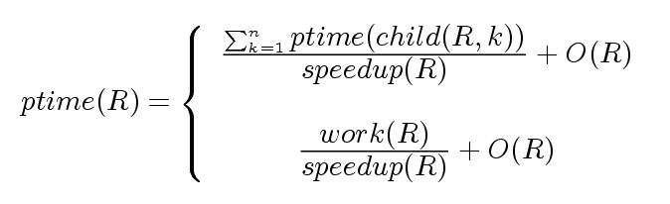
Parallel Execution Time Model:
A Bottom-up Approach
Bottom-up evaluation with each region’s estimated speedup and parallelization overhead O(R)
R is a non-leaf region
R is a leaf region
ptime(loop i)
loop i
speedup=4.0
ptime
(loop j)
ptime
(loop k)
loop j
speedup=4.0
loop k
speedup=1.0
foo()
speedup=1.0
bar1()
speedup=1.0
bar2()
speedup=1.0
Notes:
WHAT IS SPEEDUP?
When each region’s speedup is estimated,
Parkour can estimate the parallel execution time of the whole program,
Incorporating region-specific parallelization overhead O(R).
With hierarchical region model, the parallel execution time of a parent region is
affected by the parallel execution time of children regions.
Considering this characteristics of hierarchical region model,
Parkour evaluates the parallel execution time of a program in a bottom-up fashion.
Thus, it starts evaluating the parallel execution time of leaf regions.
Since they don’t have children regions, the parallel execution time is estimated as
work divided by speedup added with parallelization overhead.
It then evaluates the execution time of loopj, loopk, and finally loop i –
eventually estimates the parallel execution time of the whole program.
And then parkour calculates the estimated speedup based on serial execution time.

Slide 35
More Details in the Paper
How do we reduce the log file size of HCPA
by orders of magnitude?
What is the impact of exploitability
in speedup estimation?
How do we predict superlinear speedup?
And many others…

Slide 36
Outline
Introduction
  Background: Critical Path Analysis
  How Kismet Works
Experimental Results
Conclusion
Notes:
12:45
Now I’m going to talk about critical path analysis which Parkour extends,
and then show how parkour works with an example,
and then present the challenges in Parkour.
Let’s examine critical path analysis.

Slide 37

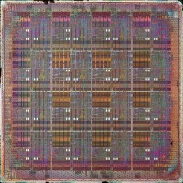
Methodology
Compare estimated and measured speedup
To show Kismet’s wide applicability,
we targeted two very different platforms
Platform
Processor | 8 * Quad Core AMD Opteron 8380 | 16-core MIT Raw
Parallelization Method | OpenMP (Manual) | RawCC (Automatic)
Exploitable Parallelism | Loop-Level Parallelism (LLP) | Instruction-Level Parallelism (ILP)
Synchronization Overhead | High ( > 10,000 cycles) | Low ( < 100 cycles)
Multicore
Raw
Notes:
Focus on “the multicore”
We compared Parkour estimated speedup against actual measured speedup.
To show Parkou’s wide applicability,
We target two very different platforms.
The first platform is Raw with 16-core MIT raw processor.
On Raw platform, an automatic parallelizing compiler called RawCC
Parallelizes code, exploiting instruction level parallelism with very low parallelization overhead.
The other platform is multicore with conventional AMD multicore processor.
On Multicore platform, we specifically target manual OpenMP parallelization
That exploits loop-level parallelism.
Unlike Raw, the parallelization cost on Multicore is quite high.

Slide 38
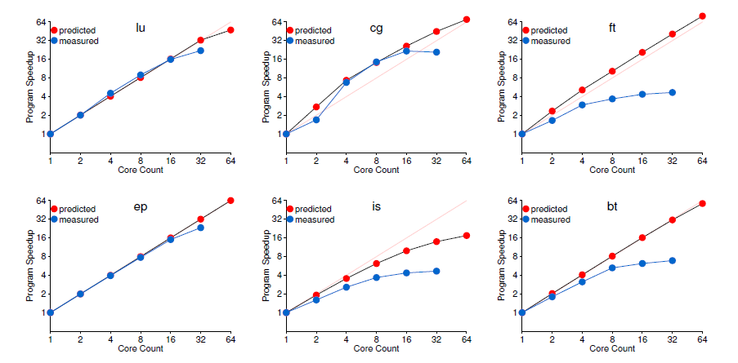
Speedup Upperbound Predictions:
NAS Parallel Benchmarks
Notes:
Use a different color coding

Slide 39
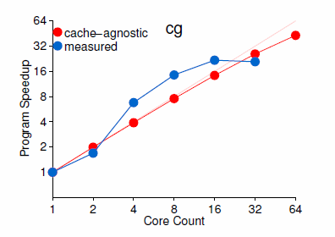
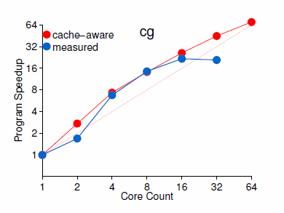
Speedup Upperbound Predictions:
NAS Parallel Benchmarks
Predicting Superlinear Speedup
Without Cache Model
With Cache Model
Notes:
Use a different color coding

Slide 40
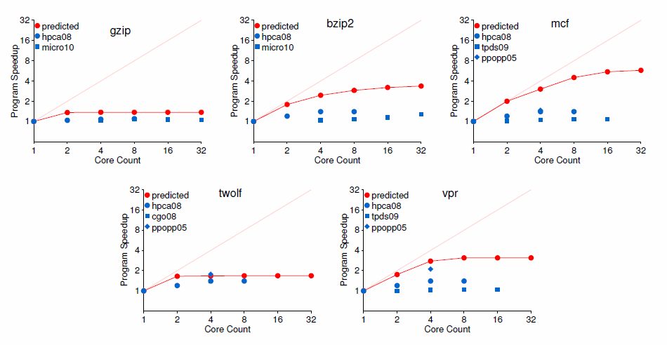
Speedup Upperbound Predictions: Low-Parallelism SpecInt Benchmarks
Notes:
Reoder graphs in the order of our preference
Regenerate these graphs with y axis range (1 – 32)
Added linear speedup line (dotted)
Use color

Slide 41
Conclusion
Kismet provides parallel speedup upperbound
from serial source code.
HCPA profiles self-parallelism using a hierarchical
region model and the parallelization planner finds
the best parallelization strategy.
We demonstrated Kismet’s ability to accurately
estimate parallel speedup on two different platforms.
Kismet will be available for public download
in the first quarter of 2012.
Notes:
Let me conclude this talk.

Slide 42
***

Slide 43
Self-Parallelism for
Three Common Loop Types
Loop Type
DOALL
DOACROSS
Serial
CP
CP
CP
CP
Loop’s
Critical Path
Length
(cp)
…
…
CP
CP
CP
CP
…
CP
CP
(N/2) * CP
N * CP
Work
N * CP
N * CP
N * CP
Self-
Parallelism
N * CP
N * CP
N * CP
= N
= 2.0
= 1.0
CP
(N/2) * CP
N * CP
Notes:
PUT SELF PARALLELISM NUMBERS IN RED
We have examined a DOALL loop example where all iterations are independent of each other,
but Parkour’s self-parallelism calculation works well for other loop types as well.
With a DOACROSS loop where half of the work in an iteration can overlap with the next iteration,
the critical path length of the loop is (N/2) * CP, and resulting self-parallelism is 2.0 which conforms to our intuition.
For a serial loop where the critical path length is identical to the adjusted work,
the calculated Self-parallelism is 1.0.
In all cases, Parkour successfully quantifies self-parallelism by extending CPA.

Slide 44
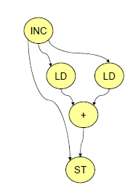
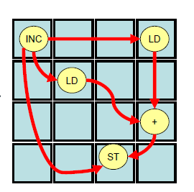
Raw Platform:
Target Instruction-Level Parallelism
Exploits ILP in each basic block
by executing instructions on multiple cores
Leverages a low-latency inter-core network
to enable fine-grained parallelization
Employs loop unrolling to increase ILP in a basic block
RawCC
Notes:
12:05
Let’s examine more about parallelization on Raw Platform.
Raw exploits instruction level parallelism in a basic block
by executing instructions on different cores.
The left graph shows instruction dependence graph in a basic block –
Each instruction executes on different cores on the right,
as parallelized by RawCC.
This fine-grained parallelization is possible with Raw;ls low-latency inter-core netrwork.
Since the amount of ILP is typically limited,
Raw uses loop unrolling to increase the amount of ILP in a basic block.

Slide 45
Adapting Kismet to Raw
Constraints to filter unprofitable patterns
  Target only leaf regions as they capture ILP
  Like RawCC, Kismet performs loop unrolling to increase ILP, possibly bringing superlinear speedup
Greedy Planning Algorithm
  Greedy algorithm works well as leaf regions will run independent of each other
  Parallelization overhead limits the optimal core count for each region
ILP
Non-ILP
A
B
C
D
E
F
16 Cores
8 Cores
16 Cores
Notes:
12:07
Now I’m going to talk how we adapted Parkour to Raw.
As we have discussed, Raw exploits ILP for parallelization.
Fortunately, ILP is captured in hierarchical region model with leaf regions.
Thus, Parkour set non-leaf regions as non-exploitable
and focuses on only leaf regions.
We use greedy planning algorithm to find the best core allocation
because each leaf region will be exclusively executed at a time.
Parkour finds the optimal number of cores based on parallelization cost and
Region’s work, and then estimates the parallel execution time of the whole program.

Slide 46
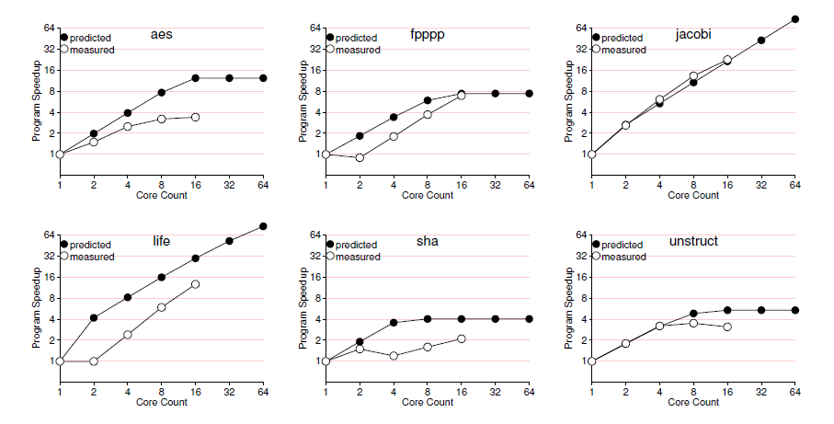
Speedup Upperbound Predictions:
Raw Benchmarks
Superlinear Speedup

Slide 47
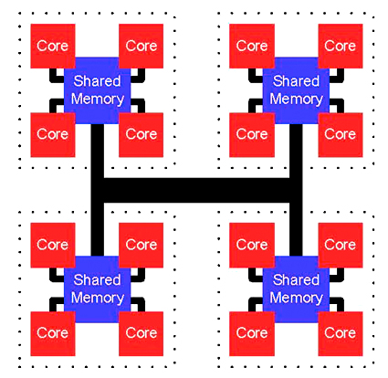
Multicore Platform:
Target Loop-Level Parallelism
Models OpenMP parallelization focusing on loop-level parallelism
Disallows nested parallelization due to excessive synchronization overhead via shared memory
Models cache effect to incorporate increased cache size from multiple cores
Notes:
12:12
SHOULD we put AMD machine here?
Now let’s examine multicore platform.
Unlike Raw platform, Multicore platform focuses on loop-level parallelism.
We also disallows nested parallelization due to excessive synchronization cost in the platform.
As you can see in this figure, Multicore platform uses shared memory for synchronization,
and the cost is high in general.

Slide 48
Adapting Kismet to Multicore
Constraints to filter unprofitable OpenMP usage
  Target only loop-level parallelism
  Disallow nested parallelization
Bottom-up Dynamic Programming
  Parallelize either parent region or a set of descendants
  Save the best parallelization for a region R in Solution(R)
Parallelize the Parent
Parallelize Descendants
A
A
32 Cores
8 Cores
Parallelize
B
C
B
C
Don’t Parallelize
32 Cores
D
E
F
D
E
F
Solution (A) = {A:32} or {C:8, D:32}
Notes:
(NOTprofitable in OpenMP)
We adapted parkour to multicore with those constraints –
Target loop-level parallelism and disallow nested parallelization.
With these constraints, we developed a bottom-up dynamic programming algorithm.
First, we set non-loop regions as not exploitable.
Then, prohibiting nested parallelization brings an interesting property in parallelization planning.
You can either parallelize the parent region in a region hierarchy
or a set of descendant regions.
Parkour saves the best parallelization for each region R in Solution(R)
and propagates the solution to its parent.
In this example, Solution for B and D is parallelizing D with 32 cores,
And Solution for C, E, F is parallelizing C with 8 cores.
Combining these two solutions, Parkour estimates the parallel execution time
And compares it against the estimated parallel execution time when only parent region is parallelized.
In this manner, Parkour can find the best core allocation on the multicore platform.

Slide 49
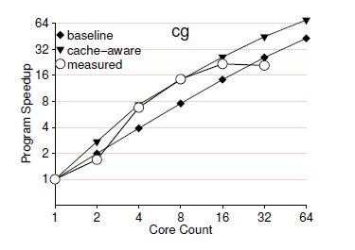
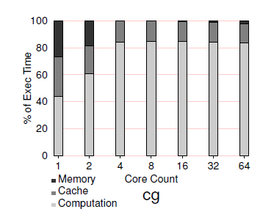
Impact of Memory System
Gather cache miss ratios for different cache sizes
Log load / store counts for each region
Integrate memory access time in time model

