Slide 1
SD-VBS:
The San Diego Vision Benchmark Suite
Sravanthi Kota Venkata, Ikkjin Ahn, Donghwan Jeon,
Anshuman Gupta, Chris Louie, Saturnino Garcia, Serge Belongie,
Michael B. Taylor
Computer Science and Engineering
University of California, San Diego
http://parallel.ucsd.edu/vision
Notes:
Hello, my name is Sravanthi Kota Venkata. Today I'm going to talk about the San Diego Vision Benchmark Suite, which is a computer vision benchmark suite that we've created at UC San Diego. My collaborators include Ikkjin Ahn, Donghwan Jeon, Anshuman Gupta, Chris Louie, Saturnino Garcia, Serge Belongie and my advisor Michael Taylor. Our benchmark suite will be available online shortly at http://parallel.ucsd.edu/vision

Slide 2
Vision is an exciting application domain for many-core and multi-core systems
“Enabling computers to see” will have a tangible and immediate impact on people’s lives
Limitless thirst for computation
  Larger image sizes
  More accurate analyses
  Match and search against larger databases
  Run the algorithm in real-time, or even super-real-time
Full of parallelism to put those idle cores to work
  i.e. drive user demand for future multi-core processors and keep Moore’s Law going
Enormous progress in computer vision research over the last decade, and more to come
  Some problems are now even considered “solved.”
Notes:
Vision is a very exciting application domain for many-core and multi-core systems. Enabling computers to see will have a very tangible and immediate effect on all our lives. For architects, vision is amazing because of its limitless thirst for computation. No matter how fast your algorithms run, you can always feed larger images, have more accurate analyses or match and search against large image databases and even try to run your algorithms in real-time or even super-real time.
Vision domain has immense inherent parallelism, which can put the idle cores to work and in turn drive user demand for multi-core processors and keep Moore’a law going.
Computer vision has seen enormous progress in the last decade and there is much more to come. Some problems have even been considered solved.

Slide 3
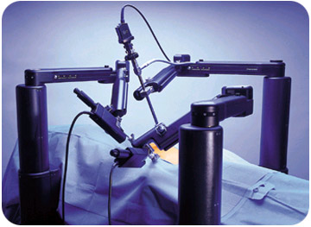
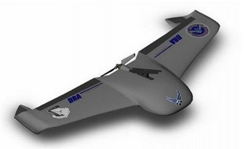
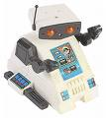

A Few Examples of Vision’s
Current and Potential Impact on Our Lives
Auto-focus cameras and cell-phones through face detection
Help doctors perform surgery on patients thousands of miles away
Allow planes to fly themselves (e.g., UAVs)
Enable “cars that can’t crash”
Enable machines that automatically educate our kids (!)
Notes:
Let us look at a few examples of vision’s current and potential impact on our lives.
Auto-focus in cameras and cell phones use face detection algorithm of Computer Vision. Vision applications have also been used to help doctors perform surgeries on patients thousands of miles away. In UAV’s computer vision allows the planes to fly themselves and someday, we want vision to give us “cars that cannot crash” and also probably machines that can educate our kids!

Slide 4
SD-VBS: The San Diego Vision Benchmark Suite
Aim: Make vision more accessible to multi-core researchers through a comprehensive and easy to use suite.
9 benchmarks in 4 different areas.
Benchmark | Concentration Area
Disparity Map | Motion, Tracking and Stereo Vision
Feature Tracking | Motion, Tracking and Stereo Vision
Image Segmentation | Image Analysis
Scale Invariant Feature Transform (SIFT) | Image Analysis
Robot Localization | Image Understanding
Support Vector Machines (SVM) | Image Understanding
Face Detection | Image Understanding
Image Stitch | Image Processing and Formation
Texture Synthesis | Image Processing and Formation
Notes:
SD-VBS, the San Diego Vision Benchmark Suite, has been made with the aim to make computer vision more accessible to multi-core researchers. SD-VBS is a comprehensive and clean suite with 9 benchmark chosen across 4 different concentration areas of vision – Motion, Tracking and Stereo Vision; Image Analysis; Image Understanding and finally Image Processing and Formation. Motion, Tracking and Stereo Vision concentration is represented by Disparity Map and Feature Tracking. Image Analysis has Image Segmentation and Scale Invariant Feature Transform. Image Understanding in represented by Robot Localization, SVM and Face Detection. Finally Image stitch and Texture synthesis represent Image Processing and Formation domain.

Slide 5
Design goals of SD-VBS
Clean implementations for ease of analysis and transformation by researchers or their tools
  “Clean” C and MATLAB versions
  No dependence on custom libraries
Comprehensive collection of representative benchmarks
Low complexity of porting and parallelizing to different platforms
Notes:
The design goal of SD-VBS is to have a clean and comprehensive implementation of vision benchmarks. The algorithms have been coded in both C and Matlab. The C versions do not have dependence on any custom-build libraries, which makes them portable across different platform. So, again, SD-VBS is a comprehensive collection of representative vision benchmarks.

Slide 6
SD-VBS: 9 applications, > 25 kernels
Support
Vector
Machines
Disparity
Map
Face
Detection
Texture
Synthesis
Image
Segmentation
Feature
Tracking
Robot
Localization
Image Stitch
SIFT
Gradient
LS Solver
Particle Filter
Interpolation
Matrix Invert
Physical Model
Affine
Transforms
Adjacency
Matrix
Area Sum
Conjugate
Matrix
Sort
Adaboost
SVD
Filter Banks
SSD
Integral Image
ANMS
PCA
Eigensolver
Matrix Ops
Gaussian
Filter
QR
Factorization
Correlation
Rect Filter
Sampling
Notes:
For SD-VBS, we choose 9 representative benchmarks. The algorithms are comprised of commonly used code blocks. In the chart here, we list the benchmarks at the top. Along each benchmark is the list of the most commonly used functions, which cover a large portion of the benchmarks. There are common kernels such as Gaussian Filter, Correlation etc among the 25 kernels listed.

Slide 7
Rich Reuse of Kernels in Vision
Support
Vector
Machines
Disparity
Map
Face
Detection
Texture
Synthesis
Image
Segmentation
Feature
Tracking
Robot
Localization
Image Stitch
SIFT
Gradient
LS Solver
Particle Filter
Interpolation
Matrix Invert
Physical Model
Affine
Transforms
Adjacency
Matrix
Area Sum
Conjugate
Matrix
Sort
Adaboost
SVD
Filter Banks
SSD
Integral Image
ANMS
PCA
Eigensolver
Matrix Ops
Gaussian
Filter
QR
Factorization
Correlation
Rect Filter
Sampling
Notes:
One interesting feature about vision algorithms is the fact that these kernels, that form the basis for a vision algorithm, are heavily reused across different benchmarks. The red-dotted lines show the rich reuse of kernels. For example, Gaussian filter which is used to filter out noise from images in used by almost all benchmarks – Disparity Map, Tracking, Face Detections etc.
So, we could say that analyses of these basic functional blocks, kernels, can give an architect a very good idea about the constituency and characteristics of the computer vision domain.

Slide 8
Overview of Talk
Introduction to SD-VBS
Vision Benchmarks Overview
  foreach { Feature Tracking, Disparity, Image Stitch, SIFT,
  Segmentation, SVM, Robot Localization,
  Texture Synthesis } :
  Brief Demo
  Algorithm Description
  Analysis of Characteristics and Hotspots
Results
Related Work
Conclusion
Intro | B1 | B2 | B3 | B4 | B5 | B6 | B7 | B8 | B9 | Results | Related Work | Conclusion
Notes:
Let us look at the overview of the talk – I have introduced to SD-VBS and I am going to talk about all the benchmarks in SD-VBS and follow it up with a brief algorithm and analysis for each.
The blue progress bar below gives you the status of the talk.

Slide 9
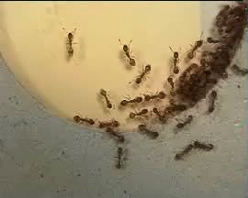
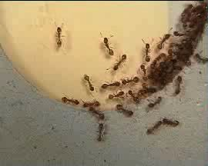

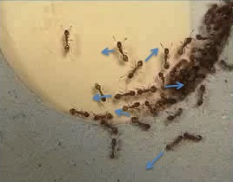
Feature Tracking: Overview
Motion of the tracked features
Process of locating moving object(s) across frames
Applications:
Cruise Control
Pedestrian Tracking
Interactive Robots
Intro | B1 | B2 | B3 | B4 | B5 | B6 | B7 | B8 | B9 | Results | Related Work | Conclusion
Notes:
The first benchmark is Feature Tracking. This is the process of locating moving objects in subsequent frames. For the given frame sequence, shown in the cascade of pictures in the left, we track the motion of the objects (ants). The output of this tracking looks like the picture to the right, where the motion of the ants across the frames in depicted by blue arrows.
Tracking algorithm is heavily used in automotive applications such as cruise control, pedestrian tracking and also Interactive robots.

Slide 10
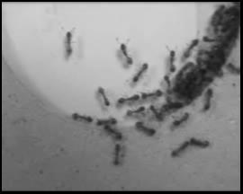
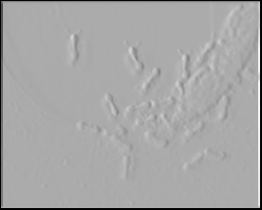
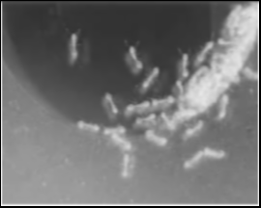
Feature Tracking: Algorithm
Image
Preprocessing
Gradient
Edge Detection
Noise filtered image
Horizontal edge image
Vertical edge image
Highly parallel: Each output pixel can be computed in parallel with others
Intro | B1 | B2 | B3 | B4 | B5 | B6 | B7 | B8 | B9 | Results | Related Work | Conclusion
Notes:
The first benchmark is Feature Tracking. Like most vision algorithms, Feature Tracking starts off with an image pre-processing stage that filters noise from the input image. In this case, we use a Gaussian filter, which is applied at the pixel level across the entire image. This stage is the first stage shown in the slide.
The second stage of the computation is to employ Edge detection, in this case, a Gradient filter, to create both Horizontal and Vertical Edge Images. Finding edges is useful because they are easy to identify between successive frames of video.
In the slide, you can see the two edge images, which make the ants stand out quite well..

Slide 11
Feature Tracking: Algorithm
Image
Preprocessing
Gradient
Edge
Detection
Feature Extraction
Σ
Σ
Sort
Σ
Edge Images
Area Sum
Features: {x,y, strength}
Intro | B1 | B2 | B3 | B4 | B5 | B6 | B7 | B8 | B9 | Results | Related Work | Conclusion
Notes:
From edge images, we now compute the feature points across image frames. By feature points we mean the pixels and their neighborhoods that have seen considerable motion across frames. For this, we take the edge images and compute the strength of each pixel neighborhood (using summation function) based on the edge content within. We sort the neighborhoods with greatest edge content and the corresponding pixels are marked as features (the red cross marks across image on the left).

Slide 12
Feature Tracking: Algorithm
Image
Preprocessing
Gradient
Edge
Detection
Feature Extraction
Feature Matching
Frame 1
Features
Frame 2
Features
Select Nearby Features
(e.g., within a range of 5x5)
then pick one with closest
strength.
< x, y, strgth>
< 0,0, 25>
< … >
< x, y, strgth>
< 6,6, 21>
< 1,1, 12>
<0,2,22>
Correlated, with Vector
Intro | B1 | B2 | B3 | B4 | B5 | B6 | B7 | B8 | B9 | Results | Related Work | Conclusion
Notes:
Each feature is characterized by a tuple – position and edge strength. So, across frames, we try to match the features from one frame with the features in the successive frames. Here, we try to find the match for feature <0,0,25> from Frame 1 with features from Frame 2. Based on the location and the strength, we find that the third feature <0,2,22> is the closest match and thus, we draw a motion vector to show this displacement. This corresponds to the red arrow in the picture to the right.

Slide 13
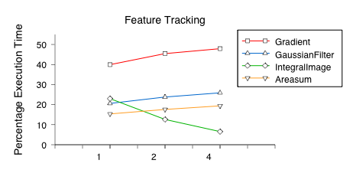
Feature Tracking: Algorithm
Image
Preprocessing
Gradient
Edge
Detection
Feature Extraction
Feature Matching
(Edge Detection)
(Image Preprocessing)
(Feature
Extraction)
Relative input size 1X, 2X, 4X - (12k, 25k, 100k pixels)
Intro | B1 | B2 | B3 | B4 | B5 | B6 | B7 | B8 | B9 | Results | Related Work | Conclusion
Notes:
This graph plots relative execution time of tracking kernels across different image sizes. We vary the image sizes from 12k pixels to 100k pixels.
As we see from the graph, Gradient kernel occupies almost 50% of the entire execution time, which corresponds to Edge Detection kernel.
So, we could say tracking is bottle-necked by edge detection phase.

Slide 14
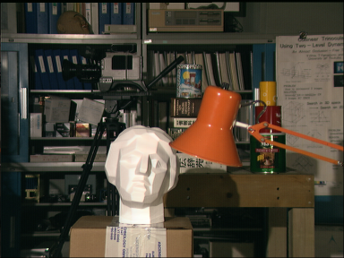
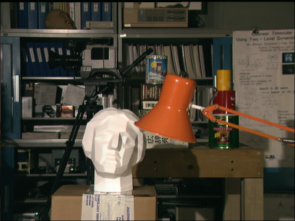
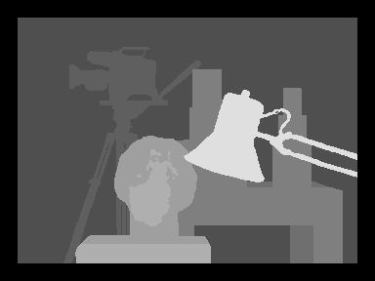
Disparity Map: Overview
Computes relative positions of objects in a scene captured by stereo cameras – depth
Intro | B1 | B2 | B3 | B4 | B5 | B6 | B7 | B8 | B9 | Results | Related Work | Conclusion
Notes:
The second benchmark is Disparity Map. This is the process of finding relative positions of objects in a scene captured from different view points. This information is the Depth information of the scene.
The input is the pair of two images and the output is a gray-scale image where the objects closest to the camera are coloured lighter and the objects farther away are colored darker.

Slide 15
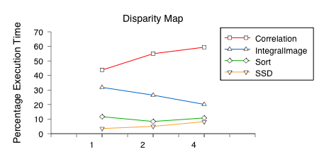
Disparity Map: Algorithm
Image Pre-
Processing
Correlate left and right pairs
Find Disparity Map
Relative input size 1X, 2X, 4X
Intro | B1 | B2 | B3 | B4 | B5 | B6 | B7 | B8 | B9 | Results | Related Work | Conclusion
Notes:
Disparity starts with an image pre-processing stage that filters out the noise. The next stage is the correlation stage where we try to correlate each pixel in left image with the ones in the right image. The intuition here is that the pixels that see maximum displacement across the two frames are the ones closer to the camera and the ones that show minimal displacement are farther away.
The relative execution time chart shows that Disparity map is occupied by Correlation stage for more than 50% of the time. And thus, we will term this kernel as the hotspot for the benchmark.

Slide 16
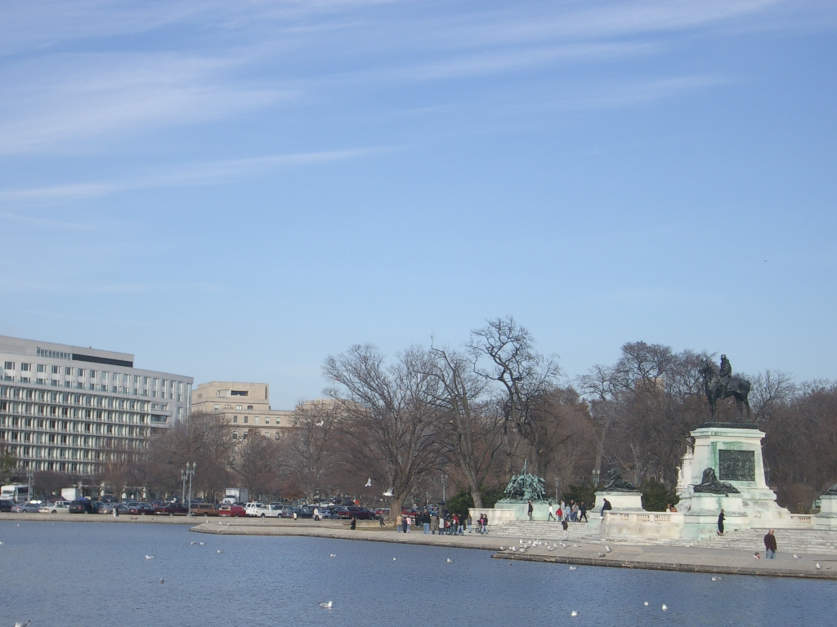
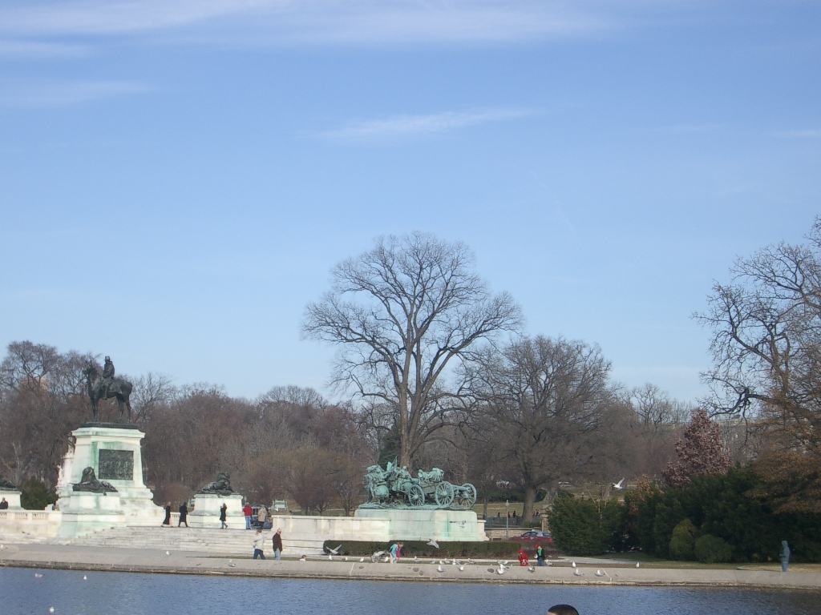
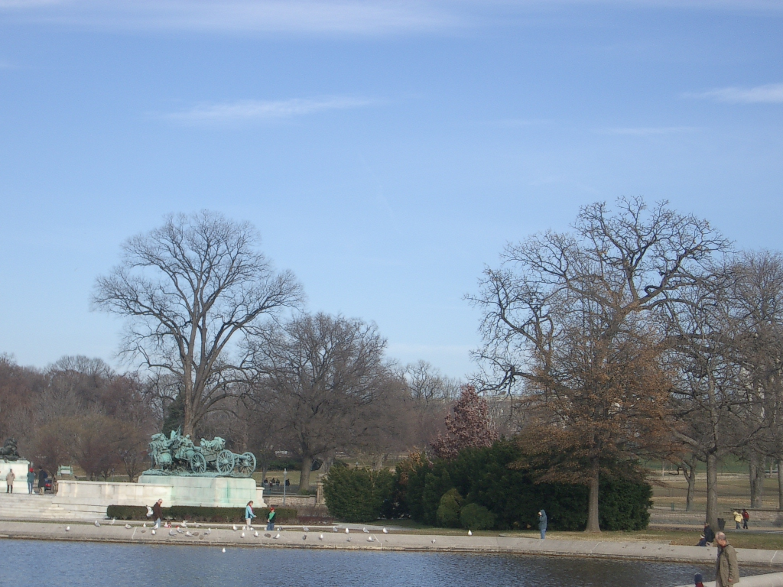
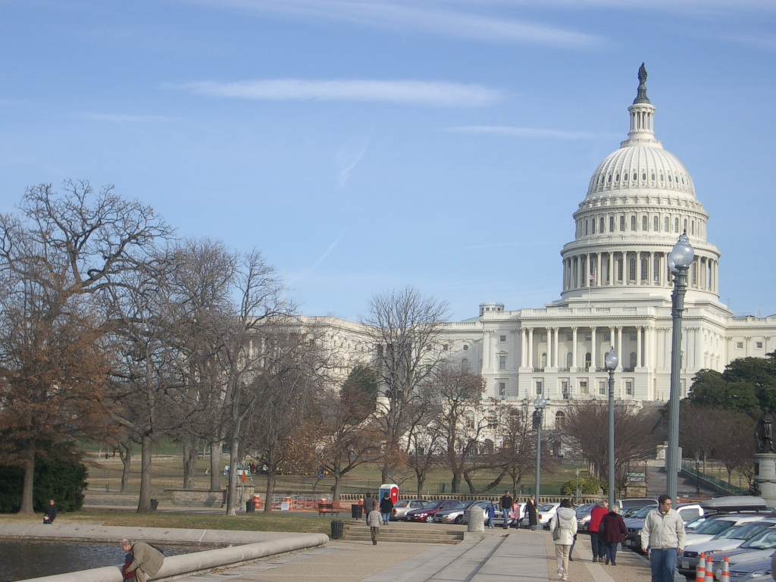
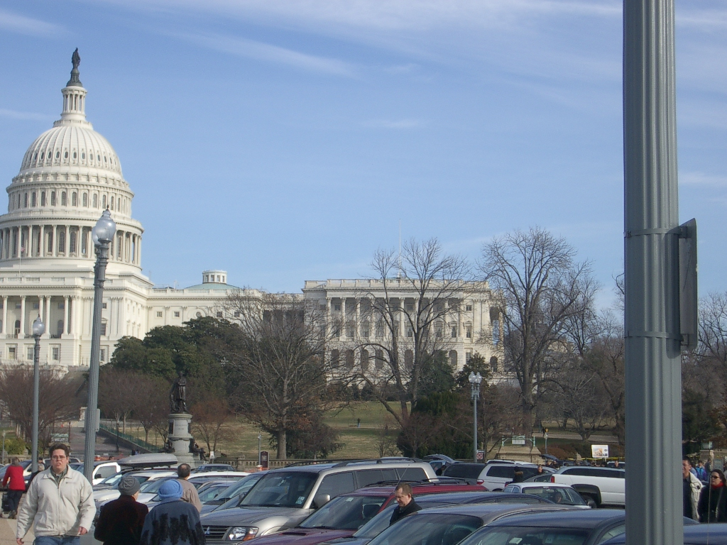
Image Stitch: Overview
Combining multiple images with overlapping view
Intro | B1 | B2 | B3 | B4 | B5 | B6 | B7 | B8 | B9 | Results | Related Work | Conclusion
Notes:
Our next benchmark is Image Stitch. This is the process of combining multiple images with overlapping view. All the images share a common scene. We combine all these 5 images to stitch a panorama.

Slide 17
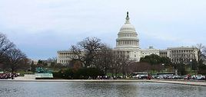
Image Stitch: Overview
Combining multiple images with overlapping view
Applications
Movie making
Google earth, GPS applications etc
Intro | B1 | B2 | B3 | B4 | B5 | B6 | B7 | B8 | B9 | Results | Related Work | Conclusion
Notes:
The panorama created looks like the image shown.
This app is widely used in movie making, google earth apps and various other GPS applications.

Slide 18
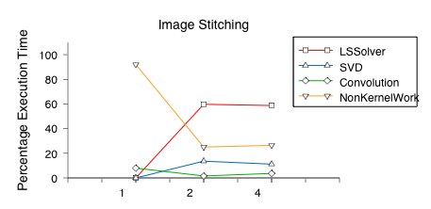
Image Stitch: Analysis
Match Features
Stitch Images
(Match Features)
(Feature Detection)
(Image pro-processing)
Relative input size 1X, 2X, 4X
Intro | B1 | B2 | B3 | B4 | B5 | B6 | B7 | B8 | B9 | Results | Related Work | Conclusion
Notes:
This algorithm has two important stages – feature detection and matching stages. These are the stages where we try to locate overlapping views of the images to stitch them. We have discussed feature extraction in Feature Tracking algorithm. We employ similar techniques to this algorithm as well.
From the chart, we see that the major occupancy of image stitch is LS Solver, which is the Match Features kernel. But for small input images, we see that LS Solver has little occupancy. The reason is that for small images, the number of extracted features are few and thus, the # computations in this phase are minimal.

Slide 19
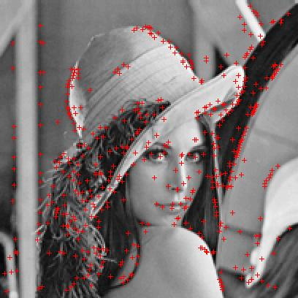
Scale Invariant Feature Transform (SIFT): Overview
Detection and description of robust local image features
Applications
Object recognition
Motion Analysis
Gesture Recognition
Intro | B1 | B2 | B3 | B4 | B5 | B6 | B7 | B8 | B9 | Results | Related Work | Conclusion
Notes:
Our next benchmark is SIFT, which is the process of extracting high contrast local image features. So, for the given input image, we are trying to localize our key points to the foreground objects.
In the images above, given the left image as input, we mark all the corner points ( shown in red dots) on the lady in the image (which is the foreground object).
SIFT is widely used in object recognition, motion analysis and gesture recognition.

Slide 20
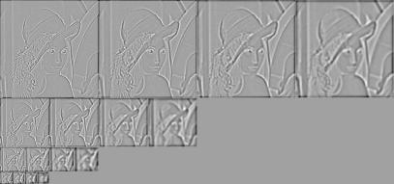
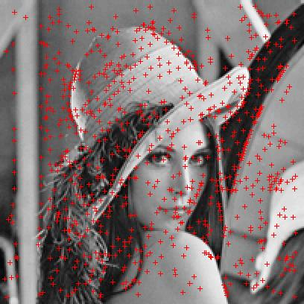
SIFT: Algorithm
Image Processing
and
Pyramid Generation
Feature Pyramid
Keypoint Detection
Remove low contrast key points
Difference of Gaussians
Pyramid – Edge Images
Corner detection
Remove low contrast key points
Intro | B1 | B2 | B3 | B4 | B5 | B6 | B7 | B8 | B9 | Results | Related Work | Conclusion
Notes:
SIFT employs feature detection similar to Feature Tracking and Image Stitch. Once it locates all the key points (corners) based on edge images, it removes all corners that have low contrast. These belong to the background. And what we are left with are he high contrast foreground features, as shown in the images above.

Slide 21
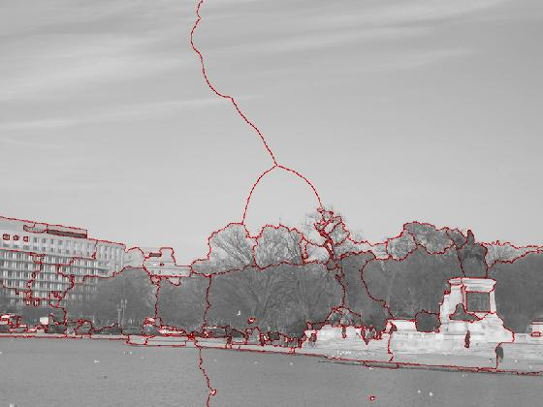
Image Segmentation: Overview
Process of partitioning an image into meaningful segments, typically used to locate objects and boundaries
Intro | B1 | B2 | B3 | B4 | B5 | B6 | B7 | B8 | B9 | Results | Related Work | Conclusion
Notes:
Our next benchmark is Image segmentation, which is the process of dividing an image into conceptual regions or segments such as boundaries, borders or objects.
For the input image shown in the left, the output would be a segmented image (shown in the right) that marks boundaries, objects etc.

Slide 22
Image Segmentation: Algorithm
Continuous edge image
Segmented image
Using the continuous edge image and high contrast matrix, we mark segments
Intro | B1 | B2 | B3 | B4 | B5 | B6 | B7 | B8 | B9 | Results | Related Work | Conclusion
Notes:
For image segmentation algorithm, it is of prime importance to find boundaries along which to cut the image.
We use edge images to find segmentations of the input image. After we extract the continuous edges from the edge images, we mark these as object boundaries.

Slide 23
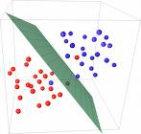
Support Vector Machine (SVM): Overview
Separation of a given set of
data into two categories with
maximal geometric margin.
Applications
Machine Learning
Neural networks
Data classification
Intro | B1 | B2 | B3 | B4 | B5 | B6 | B7 | B8 | B9 | Results | Related Work | Conclusion
Notes:
Our sixth benchmark is SVM. Support Vector Machine is a data classfication algorithm. Given a set of data points, SVM tries to find the maximal geometric margin between them. This is an iterative method and the margin depends on the number of iterations. So, greater the number of iterations, better the categorization.
SVM is widely used in machine learning, neural networks and data classification applications.

Slide 24
SVM: Algorithm
Train the classifier
based on the training
data
Evaluate the classifier
based on the testing
data
Refine the classifier
based on the testing
data
Qualify of data classification
Improves with number of
Iterations used in learning stage.
The execution time depends on the
number of data points and number
of iterations.
Intro | B1 | B2 | B3 | B4 | B5 | B6 | B7 | B8 | B9 | Results | Related Work | Conclusion
Notes:
SVM is a classic machine learning algorithm, which has two main stages – training and learning.
In training phase, we train the SVM classifier based on the training data. At the end of the training phase, we derive a polynomial function to classify the learning data.
Once we have trained the classifier, we evaluate and refine the classifier by applying it on the input data set. This stage is an iterative phase, where the quality directly depends on the number of iterations. (So, greater the number of iterations, better the polynomial fit.

Slide 25
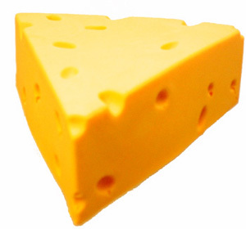
Robot Localization: Overview
Process of evaluating path based on obstacles and a set of goals
x
x
x
x
x
x
x
x
x
x
x
x
x
x
x
Applications
Space exploration programs
Autonomous vehicles/systems
Mobile robotics
x
x
x
x
x
x
x
x
x
x
Intro | B1 | B2 | B3 | B4 | B5 | B6 | B7 | B8 | B9 | Results | Related Work | Conclusion
Notes:
Our next benchmark is Robot localization. This is the process of evaluation the path of the robot based on the obstacles and a set of goals.
In the image above, give that the goal of the robot is to find the kid, the robot has the plan its path around all the obstacles (shown as red cross) to reach its destination.
This algorithm is widely used in autonomous solutions for systems, space exploration programs and mobile robotics etc

Slide 26
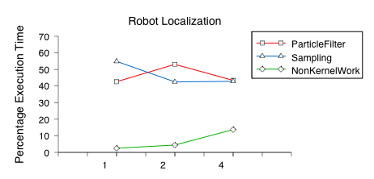
Robot Localization: Algorithm
Probabilistic models to estimate position
(Tracking)
(Estimation)
Intro | B1 | B2 | B3 | B4 | B5 | B6 | B7 | B8 | B9 | Results | Related Work | Conclusion
Notes:
This algorithm has 2 main stages – finding the position of the robot relative to its environment. And the next stage, where, based on its estimated position, it plans its future course of action.
From the chart we see that both these stages take approximately the same amount of time. Thus, this algorithm has two heavily occupied (wrt execution time) kernels in Particle Filter and Sampling.

Slide 27
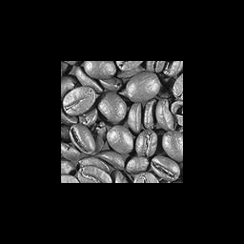
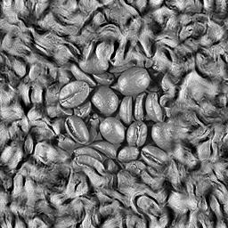
Texture Synthesis: Overview
Constructing large images from small image using structural content
Applications
Movie making
Graphics
Computational Photography
Intro | B1 | B2 | B3 | B4 | B5 | B6 | B7 | B8 | B9 | Results | Related Work | Conclusion
Notes:
Our next benchmark is Texture synthesis, which is the process of constructing large images from small input thumbnail image. We construct the large image using the structural content on the smaller image instead of just tiling it or interpolating the smaller image.
For the input thumbnail of coffee beans we synthesize a larger image, shown in the right.
This find wide applicability in movie making, graphics and computational photography

Slide 28
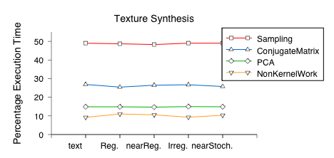
Texture Synthesis: Algorithm
(Texture Analysis)
(Texture Analysis)
(Texture Synthesis)
Intro | B1 | B2 | B3 | B4 | B5 | B6 | B7 | B8 | B9 | Results | Related Work | Conclusion
Notes:
This benchmark has two important stages – Texture Analysis and Texture Synthesis.
In texture analysis stage, we try to characterize the structural content on the input image. This is later used to synthesize the larger output image.
Once we have analyzed the structural content on the input, we synthesize the output image.
From the relative execution time chart, we see that the majority of time is occupied by the Analysis stage, about 50%. Thus, we say that analyzing the input image is the hotspot for the benchmark.

Slide 29
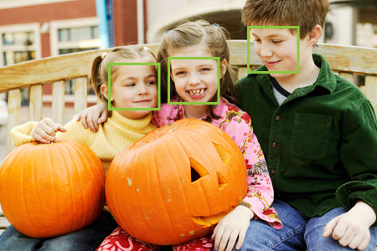
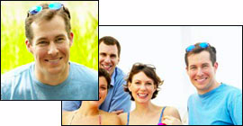
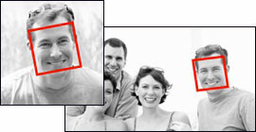
Face Detection: Overview
Determines locations and sizes of
human faces
Applications
Object tracking
Digital Camera, Facebook
Content based image retrieval
Intro | B1 | B2 | B3 | B4 | B5 | B6 | B7 | B8 | B9 | Results | Related Work | Conclusion
Notes:
Our final benchmark is Face Detection. This is the process of determining locations and sizes of human faces in images. As shown in the images, we precisely locate the faces in the given picture. An interesting fact to note is that the pumpkin is not detected as a face despite its close similarities to a human face.
Face Detection is widely used in Content Based Image Retrieval, Object Tracking, Camera etc.

Slide 30
Results: Execution Times
These times are for 1 or 2 frames of computation on a single core.
Lots of potential for making use of multi-core processors! Far enough away that we can use lots of cores, but close enough that it’s attainable with more cores.
Benchmark | 12k pixels | 25k pixels | 100k pixels
Feature tracking | 2.77 | 5.0 | 19.4
Disparity Map | 0.8 | 1.8 | 6.2
Image Stitch | 0.7 | 10.1 | 23.4
SIFT | 17.4 | 44.5 | 131
Texture Synthesis | 18.5
Image Segmentation | 8.3 | 9.2 | 8.4
SVM | Up to Thousands
Seconds per Frame
Intro | B1 | B2 | B3 | B4 | B5 | B6 | B7 | B8 | B9 | Results | Related Work | Conclusion
Notes:
Now that we have discussed all the benchmarks, we will analyze them for their execution time and the parallelism content within.
In the table, we have the execution time (in seconds) of each of the benchmark across different image sizes. The number are for the processing of 1 or 2 frames on a single core.
As we can see, each benchmark takes about 1 sec at least to process one frame. This is no where close to our goal on real time where we need computations at grater than 25 fps.
So, there is immense potential for multi-core processors, where we could use lots of cores to achieve close to real-time processing.

Slide 31
Results:
Parallelism in Vision Kernels
Benchmark | Kernel | Approx. Parallelism
Disparity | Correlation | 502
 | Integral Image | 160
 | Sort | 1,700
 | SSD | 1,800
Feature Tracking | Gradient | 71
 | Gaussian Filter | 637
 | Integral Image | 1,050
 | Area Sum | 425
 | Matrix Inversion | 171,000
SIFT | SIFT | 180
 | Interpolation | 502
 | Integral Image | 16,000
Image Stitch | LS Solver | 20,900
 | SVD | 12,300
 | Convolution | 4,500
SVM | Matrix Ops | 1,000
 | Learning | 851
 | Conjugate Matrix | 502
Parallelism calculation:
We implemented a transformation pass in LLVM infrastructure track operands through the program and determine the longest dependence chain through memory, control and instruction dependences.
Parallelism = # Instrs / Critical Path Length
The benchmarks shown on the right
have lots of parallelism!
(If you are curious, we encourage you
to go ahead and download our benchmark
suite!)
Intro | B1 | B2 | B3 | B4 | B5 | B6 | B7 | B8 | B9 | Results | Related Work | Conclusion
Notes:
Vision domain has lot of inherent parallelism. We have tried to capture this across our benchmarks. For the calculation of parallelism, we implemented a LLVM based transformation pass that tracks operands through the program to determine the longest dependence chain across memory, control and instructions.
Based on this, we compute parallelism as the # instructions divided by the critical path length.
As we see from the table, vision benchmarks have high numbers for parallelism. Disparity Map has as high as 1800, Image Stitch has 16000 parallelism etc.
If you are curious about other benchmarks, we encourage you to download our suite and experiment.

Slide 32
Related Work: Other vision codes
Performance-oriented benchmarks
  PARSEC: Body Tracking
  MediaBench – image/video compression algorithms
  Spec2000 facerec
Accuracy-oriented benchmarks (for vision research)
  Berkeley Segmentation Database and Benchmark
  PEIPA
  Muscle
  ImageCLEF
Vision Libraries
  OpenCV- Highly tuned vision toolbox
Intro | B1 | B2 | B3 | B4 | B5 | B6 | B7 | B8 | B9 | Results | Related Work | Conclusion
Notes:
Now, we will look at some of the related work in computer vision.
There are three classes of benchmarks – The first one being Performance-oriented benchmarks. These include PARSEC (that has an implementation of Body Tracking), MediaBench (that has image/video compression algorithms) and Spec2000 which has an implementation of Face Recognition algorithm.
The second class is the Accuracy Oriented Benchmarks that are targeted at vision researchers. These benchmarks strive for better algorithms. Examples include Berkeley Segmentation benchmark, PEIPA, Muscle and ImageCLEF.
One interesting class of vision corpus are the vision libraries. Among these, the most widely used is the Intel OpenCV, which is a highly tuned toolbox for vision.

Slide 33
Related Work: Intel OpenCV vs SD-VBS
 | OpenCV | SD-VBS
Goal | Tuned, Feature-loaded implementations for commercial and academic vision applications | “Pure” versions for easy analysis, transformation and parallelization in multi-core architecture research
Source Code | C++ | C or MATLAB, your choice
Platform specific optimizations | Highly Tuned for best performance on Intel and supporting architectures | Actively removed optimizations that increase code complexity
Coding style Example: FILTER | Highly flexible; full of options to change behavior of each function | Clean code without features that deter analysis
 | 2000 lines of code | 50 lines of code
 | 204 conditional statements | No conditional statements
 | Pointer Operations | Array Operations
Ease of analysis | Harder | Easier, because simpler implementations
Intro | B1 | B2 | B3 | B4 | B5 | B6 | B7 | B8 | B9 | Results | Related Work | Conclusion
Notes:
We will now compare SD-VBS with Intel Open CV.
The goal of OpenCV is to have a highly tuned, feature-loaded implementations for commercial and academic vision apps. SD-VBS goal is to have a clean and “pure” version of vision algorithms for easy analyses by architecture community.
OpenCV has source code written in C++, whereas SD-VBS has implementations in C and MATLAB.
OpenCV is highly tuned for best performance on Intel or supporting architectures, whereas SD-VBS does not have any optimizations that increase code complexity.
OpenCV is highly flexible and has lot of options to change behavior is each function. SD-VBS has a clean C code without features that deter analyses.
For example, a simple filtering function would occupy 2000 lines of code in OpenCV and has 204 conditional statements. Also, OpenCV is loaded with pointer operations. A similar filtering function in SD-VBS takes 50 lines of code with no conditional clauses. Also, we replace pointer arithmetic with array manipulations.
All these features make SD-VBS easier to analyze compared to OpenCV.

Slide 34
Conclusions
Computer Vision is an exciting domain with immense potential
Vision algorithms are full of parallelism, and can benefit from processors with greater and greater performance; which make them ideal for multi-core
SD-VBS is a comprehensive and clean benchmark suite for vision, well suited for multi-core and many-core research.
Public release
  http://parallel.ucsd.edu/vision
Intro | B1 | B2 | B3 | B4 | B5 | B6 | B7 | B8 | B9 | Results | Related Work | Conclusion
Notes:
In conclusion,
Computer Vision is a very exciting domain with immense potential.
The inherent parallelism in Vision algorithms can drive multi-core research which can put the idle core to work.
SD-VBS is a comprehensive, clean benchmark suite for vision and this is well suited for multi-core and many-core research.
SD-VBS will be shortly available on http://parallel.ucsd.edu/vision
Thank you!

Slide 35
SD-VBS:
The San Diego Vision Benchmark Suite
  http://parallel.ucsd.edu/vision
We would like to thank the following Vision researchers:
Andrea Vedaldi
Athanasois Noulas
Tom Mitchell
Javier Portilla
Eero Simoncelli
Jianbo Shi
For contributing their code and data sets to the benchmark suite.
Supported by NSF CAREER Award 0846152

Slide 36
*****

